Slide 1
Welcome to All Saints!
Welcome to All Saints!
Nigel Roberts, Headteacher
Nigel Roberts – Headteacher

Slide 2
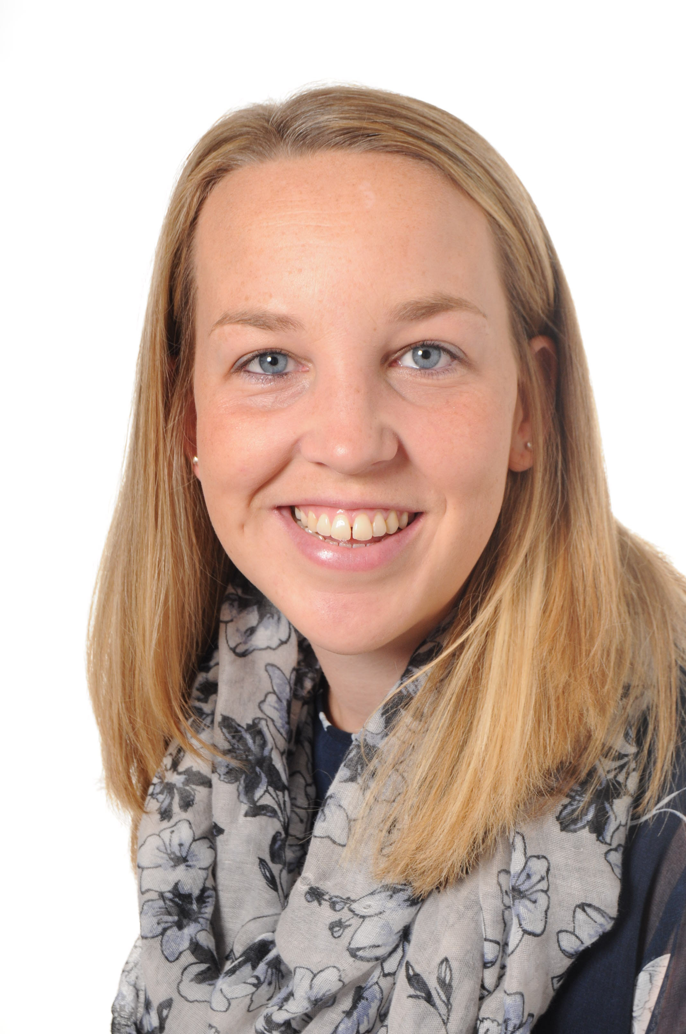
Class Teachers – Mrs Legg & Mrs Regan
Monday and Friday
Tuesday – Thursday

Slide 3
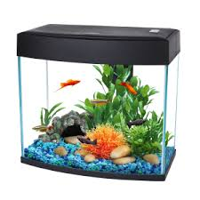
Staffing and Pets!
Spot

Slide 4
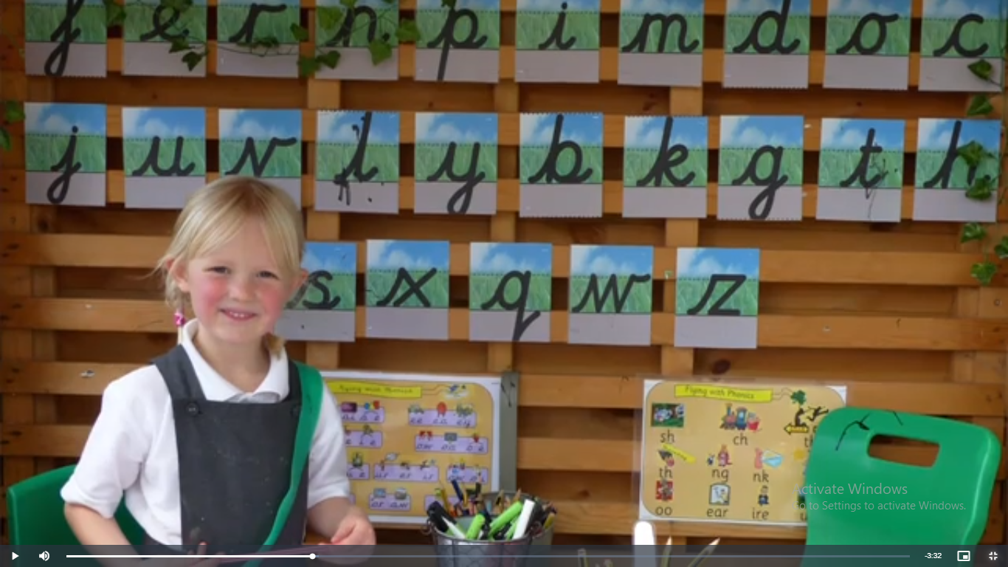
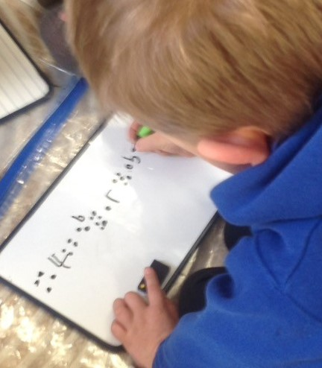
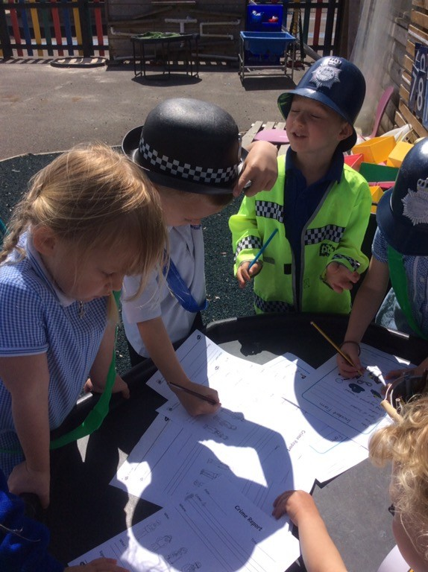
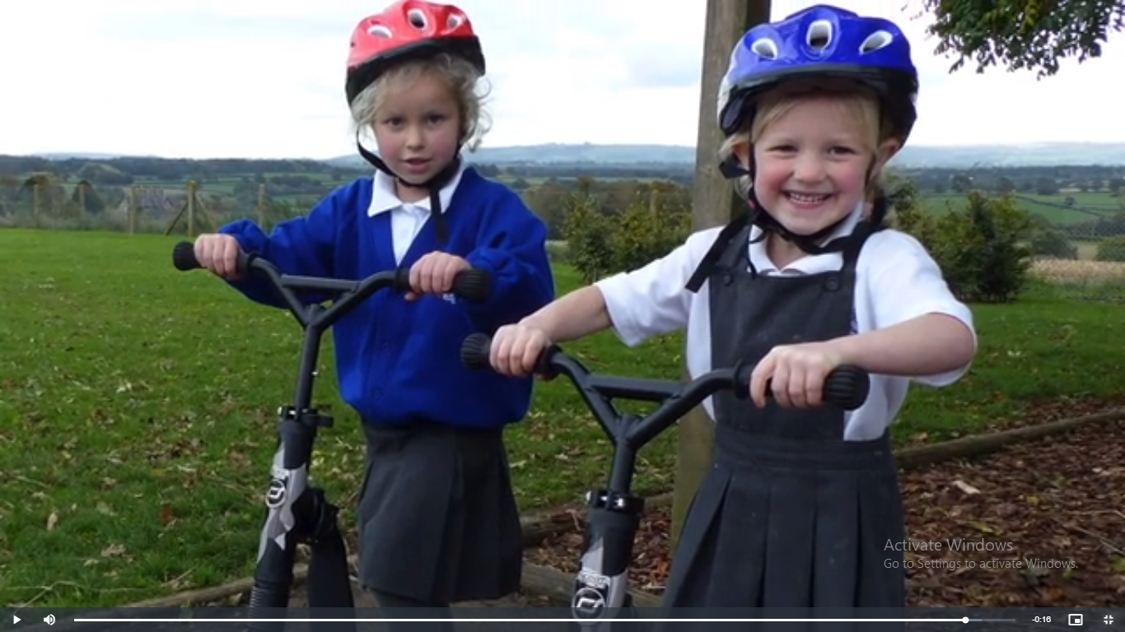
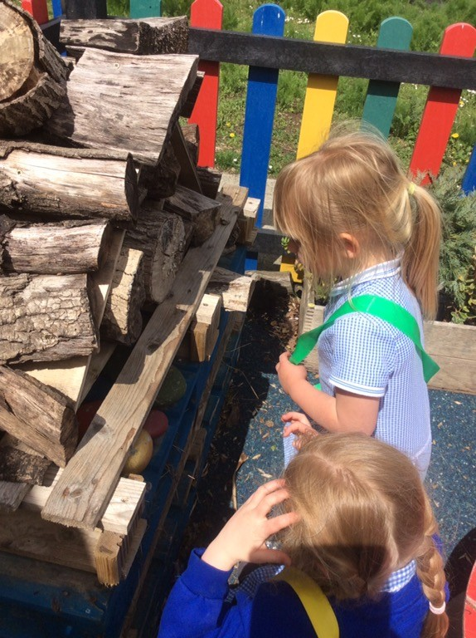
1) A Typical Day in Diamonds Class
Morning
Settling activity – linked to provision
(then moving into fluency maths as we prepare for year 1!)
Word Mechanics (phonics)
English Learning
BREAK / snack
Maths learning
Spirituality / Storm Break / Run a day!
LUNCH
Afternoon
Activities linked to the wider curriculum and following pupil interests
Worship

Slide 5
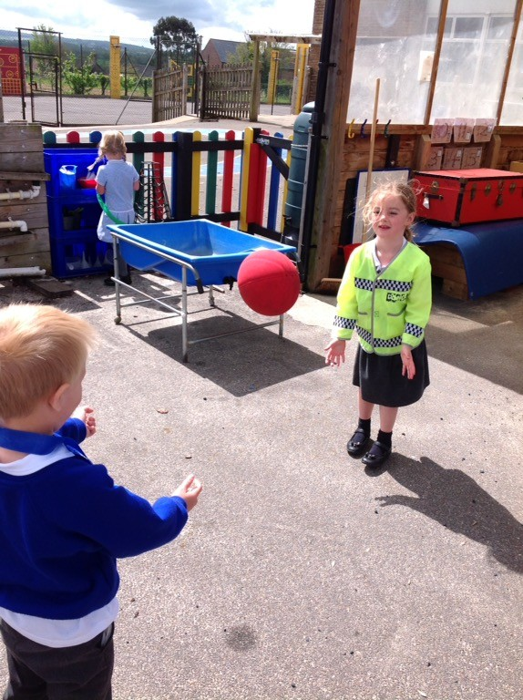
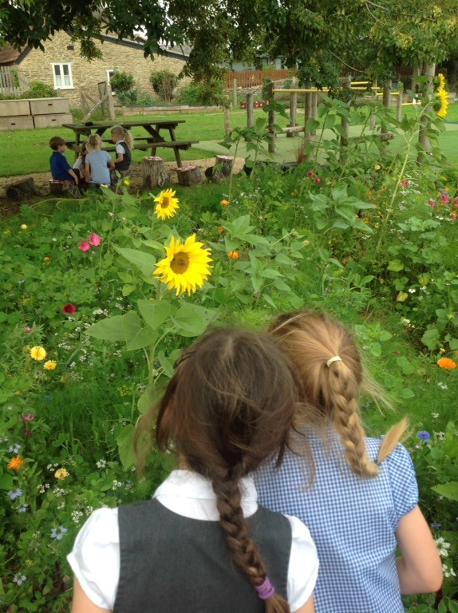
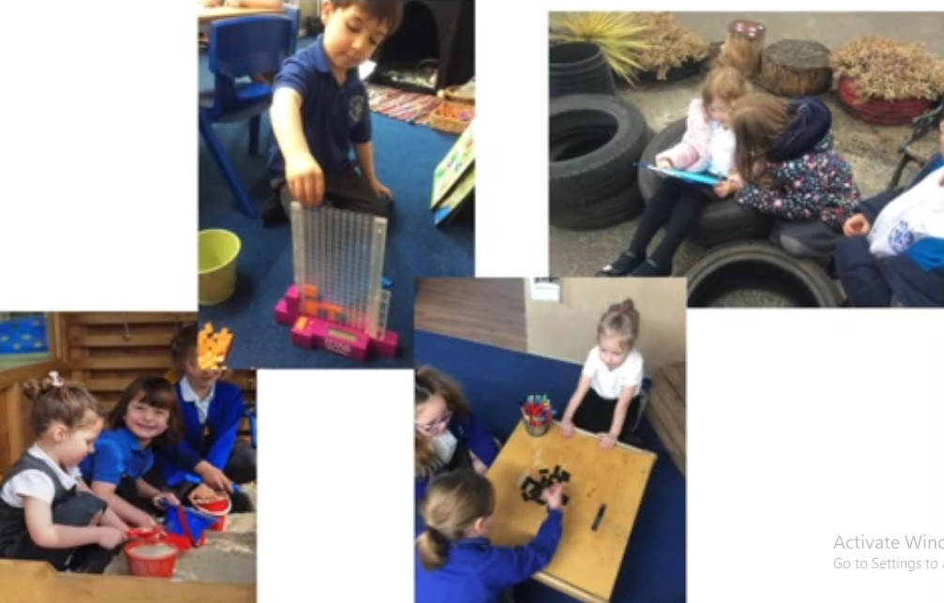
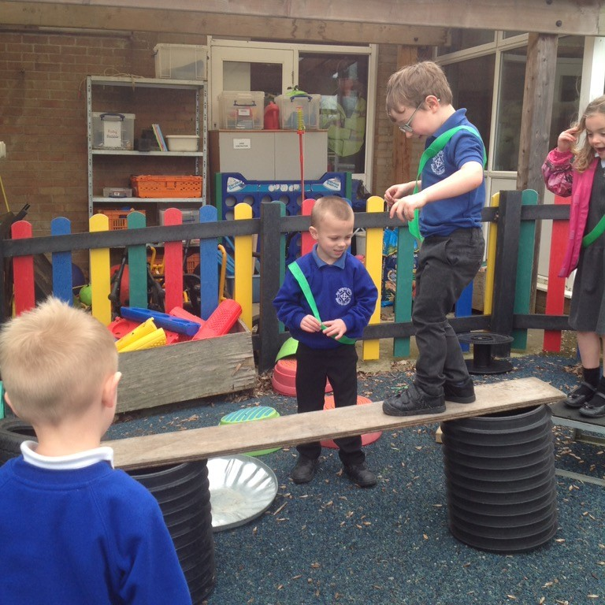
3. The EYFS framework
The areas of learning are:
PRIME AREAS:
communication and language.
physical development.
personal, social and emotional development.
SPECIFIC AREAS:
literacy.
mathematics.
understanding the world.
expressive arts and design.

Slide 6
4. Characteristics of Effective Learning COEL
In Early Years, and across the school, we look out for characteristics of effective learning, such as:
Playing and Exploring | Active Learning | Creating and Thinking Critically
Exploring | Being involved | Solving problems
Being Curious | Concentration | Making links
Following a particular interest | Perseverance | Choosing ways to do things
Have a go | Pride in work | Planning and reviewing
Role Play
These characteristics are linked to the school’s GEM POWERS, where we earn stickers and whole class rewards for displaying positive learning behaviours. This will be all explained in more detail for you in September!

Slide 7
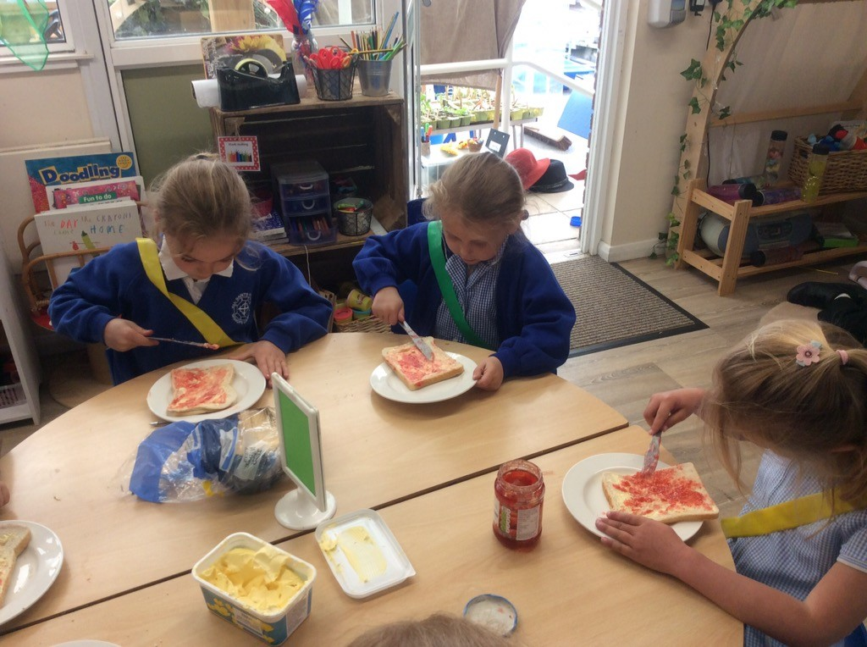
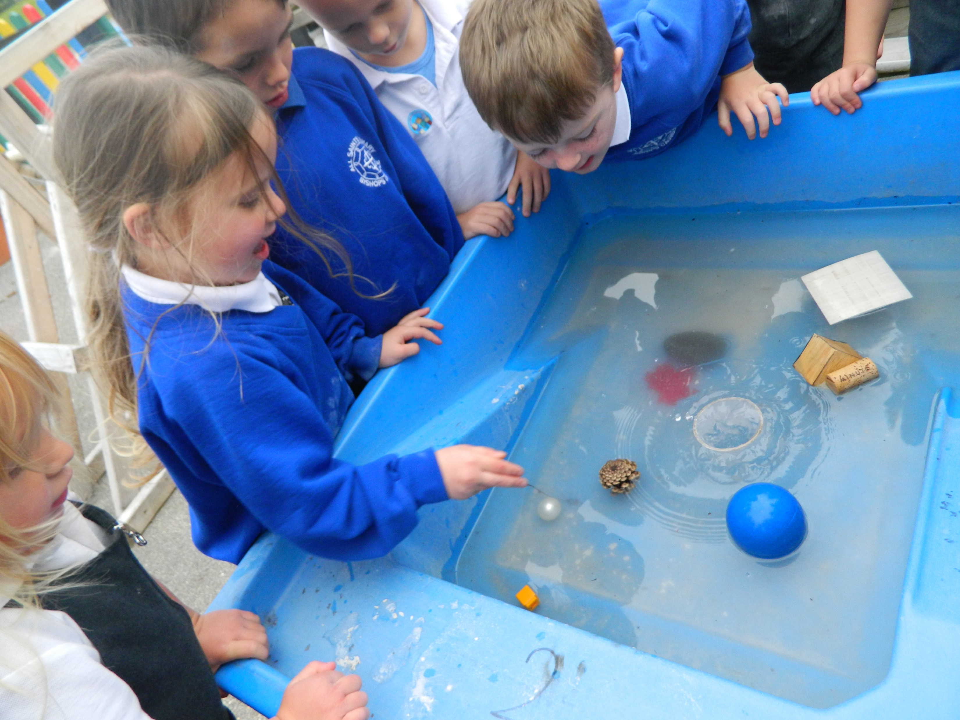
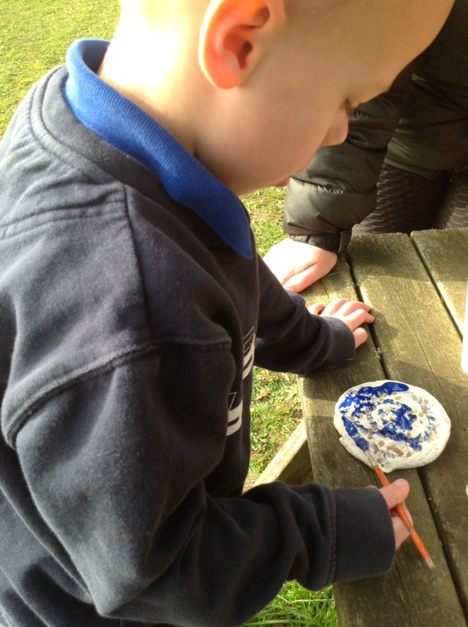
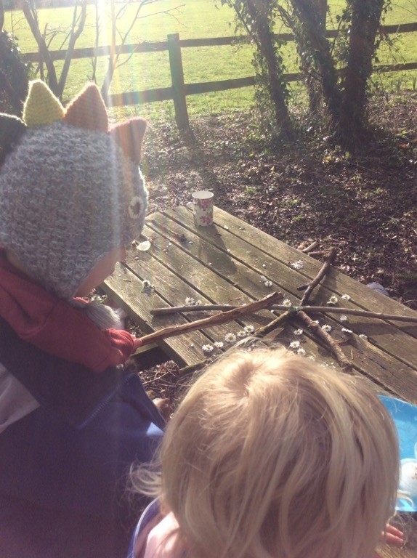
2. Learning Through Play - COOL
Forest School

Slide 8
What does the EYFS curriculum look like in reality in Diamonds?
How will my child learn?
What will they learn?
Where will they learn?

Slide 9
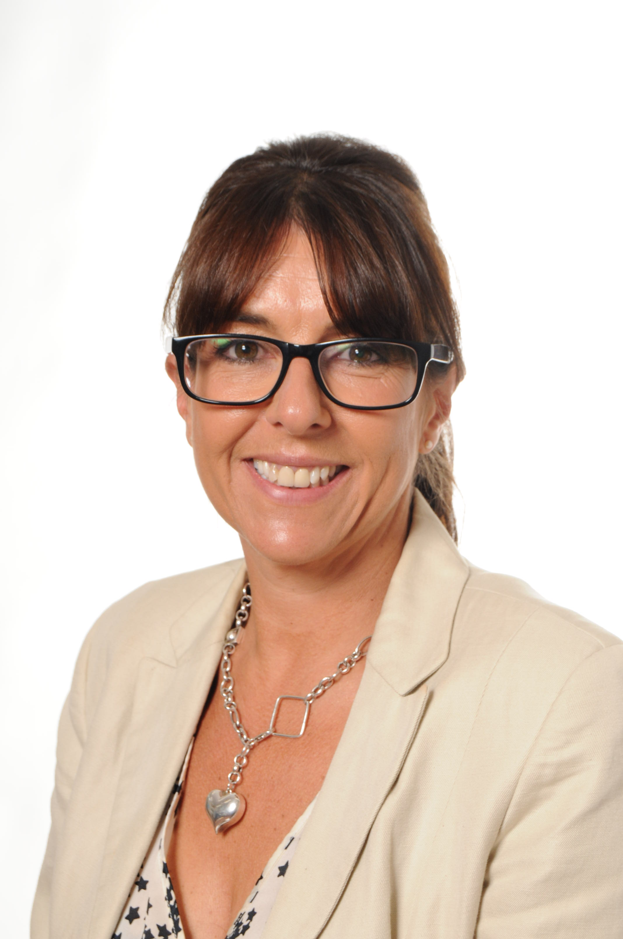
5. Communication

Slide 10
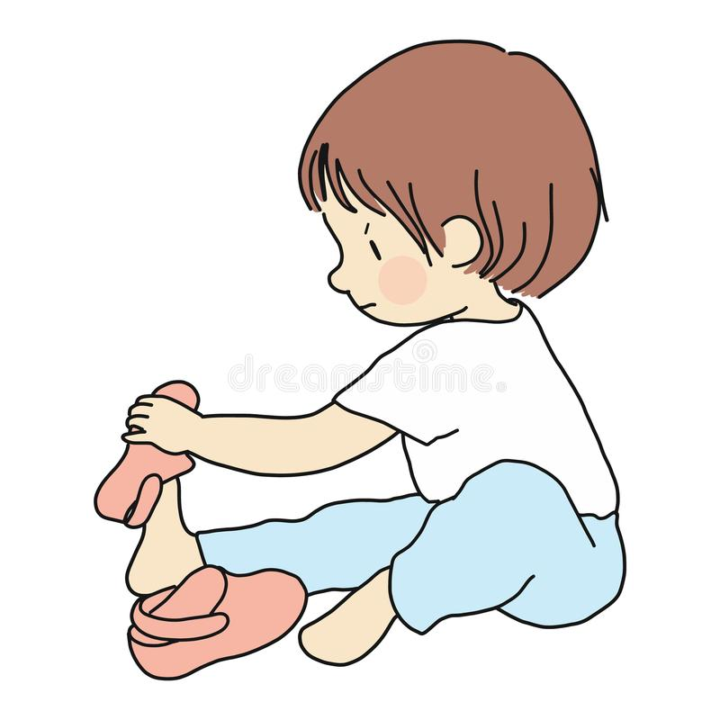
6. School Readiness
Enjoy sharing stories
Shoes
Dressed/undressed
Washing hands
Recognise my own name
Toileting
Counting together
Love of learning

Slide 11
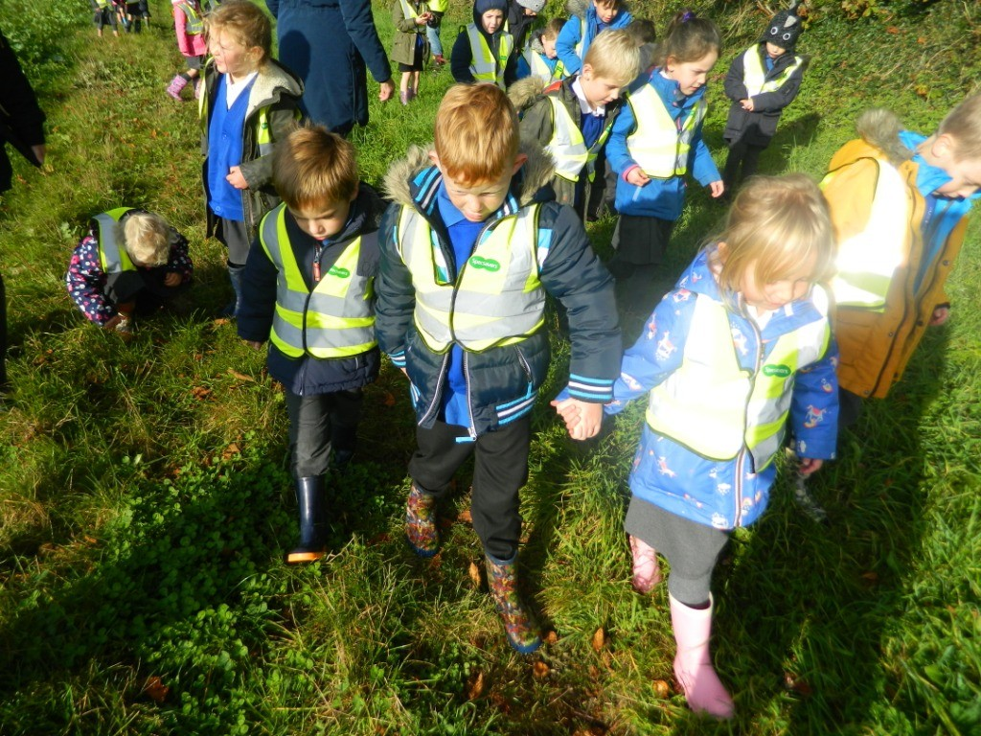
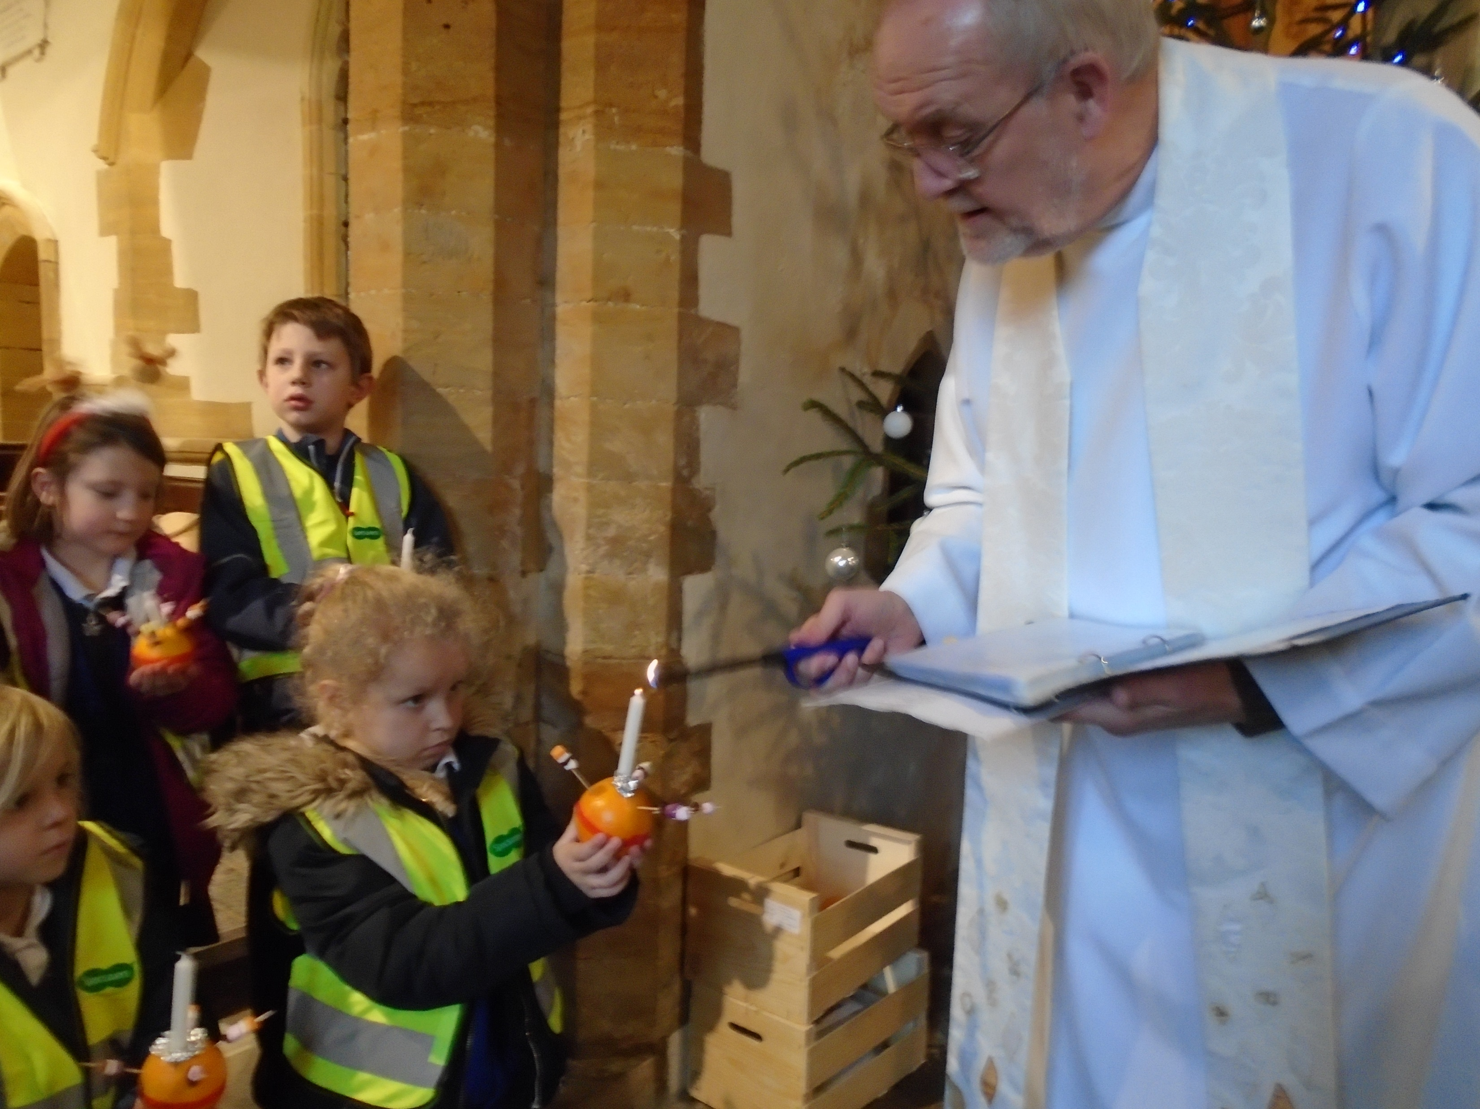
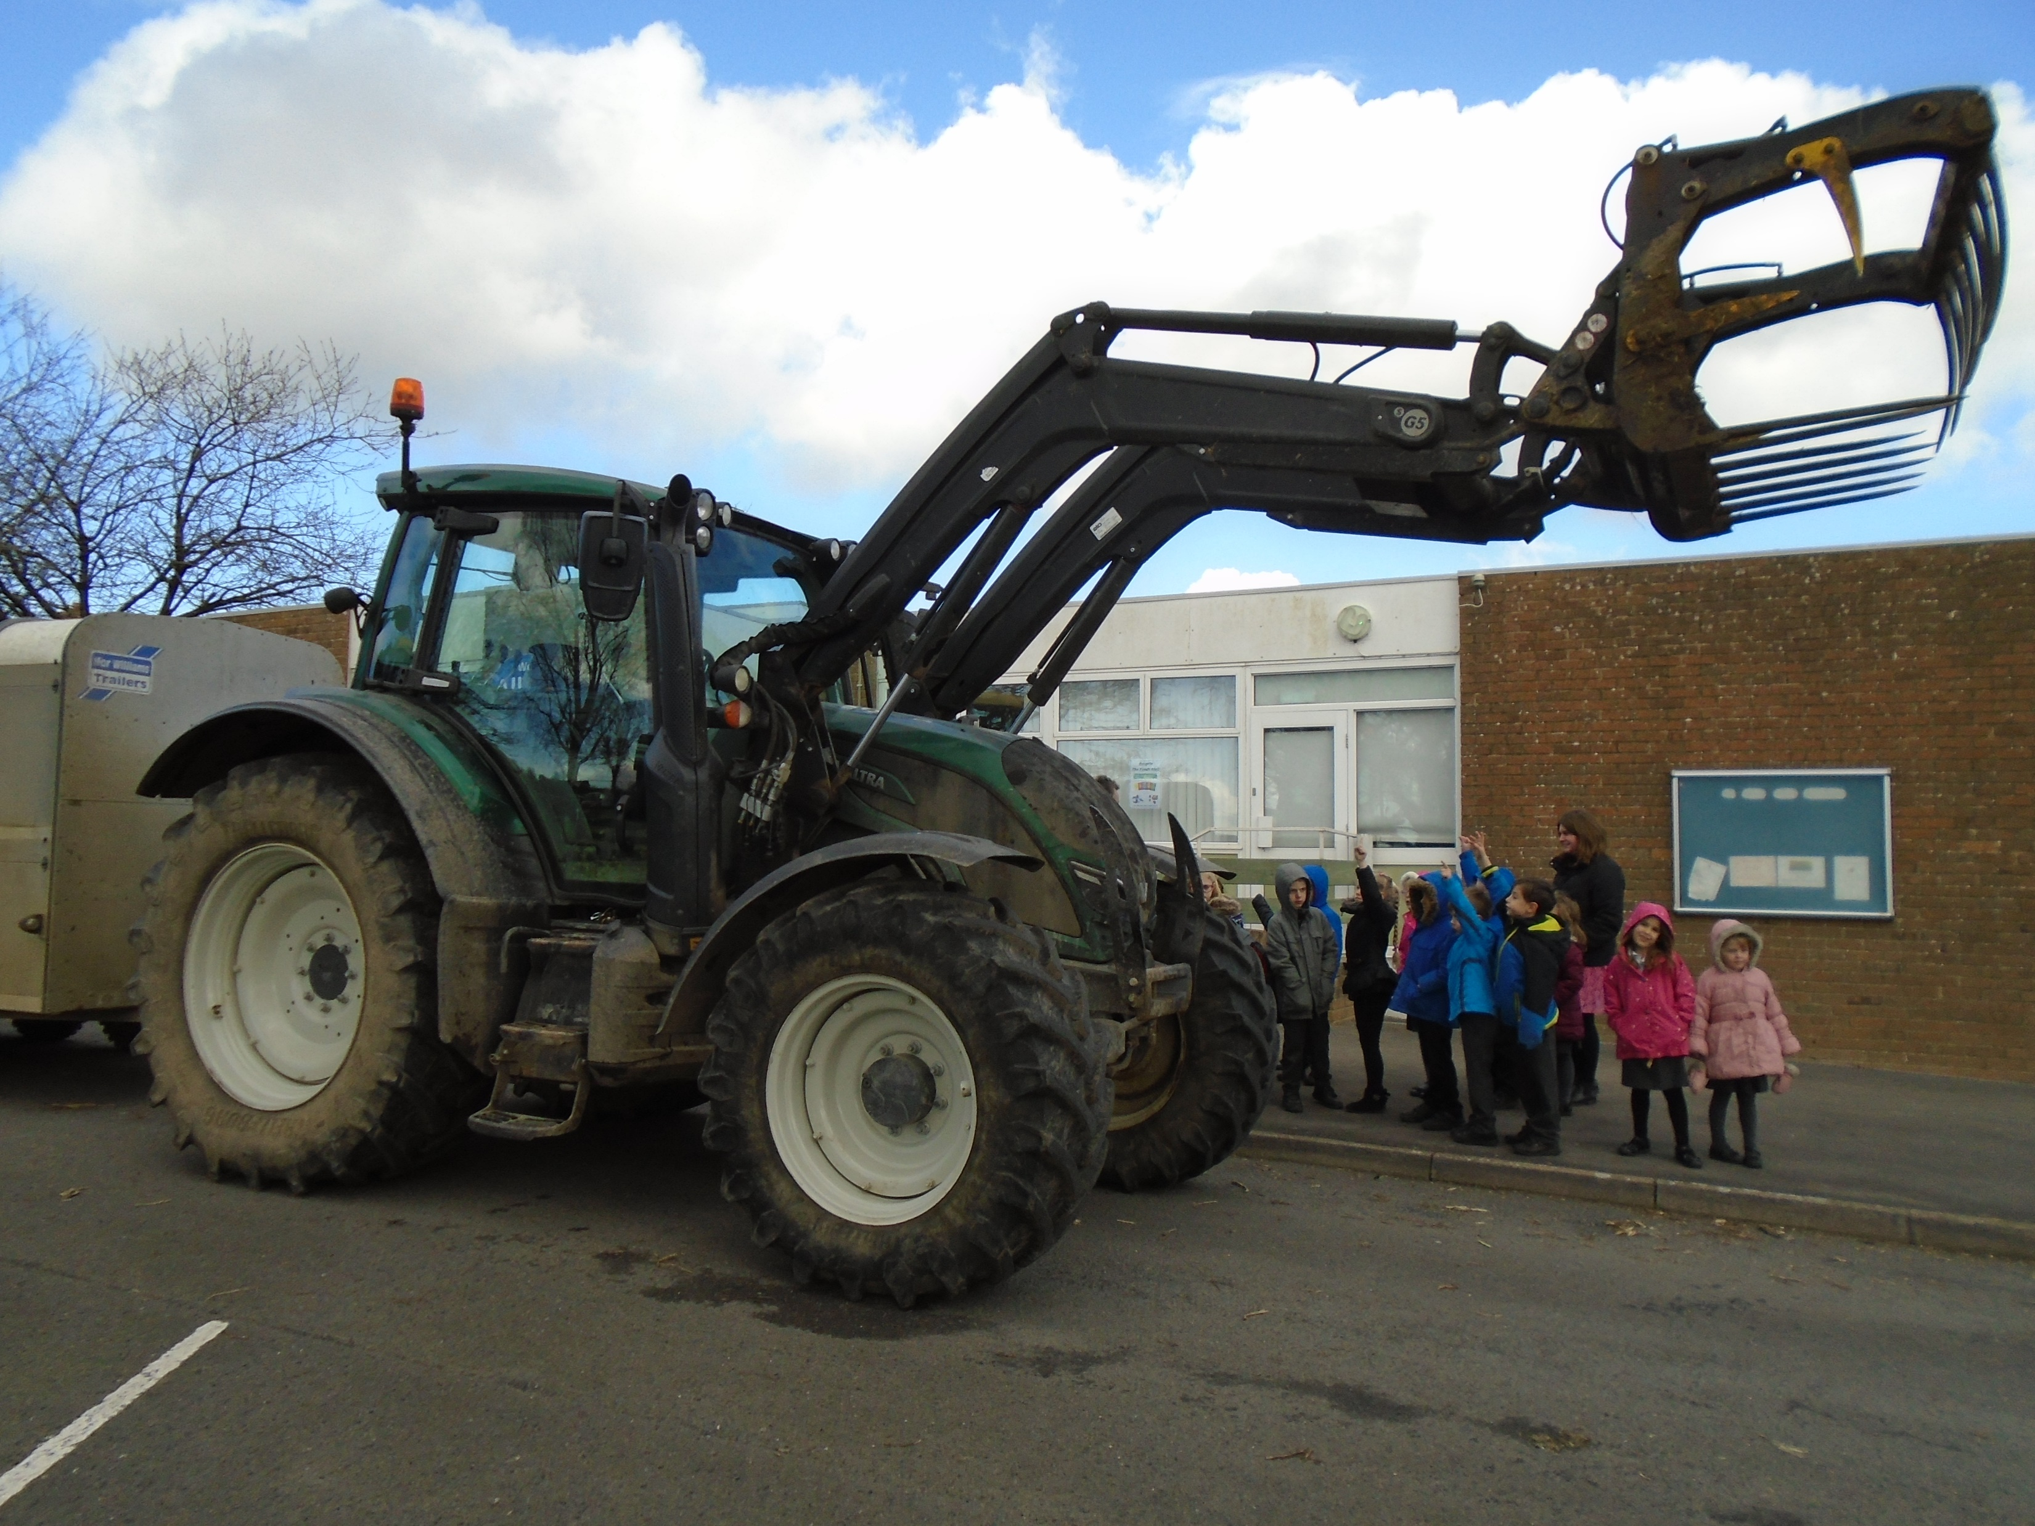
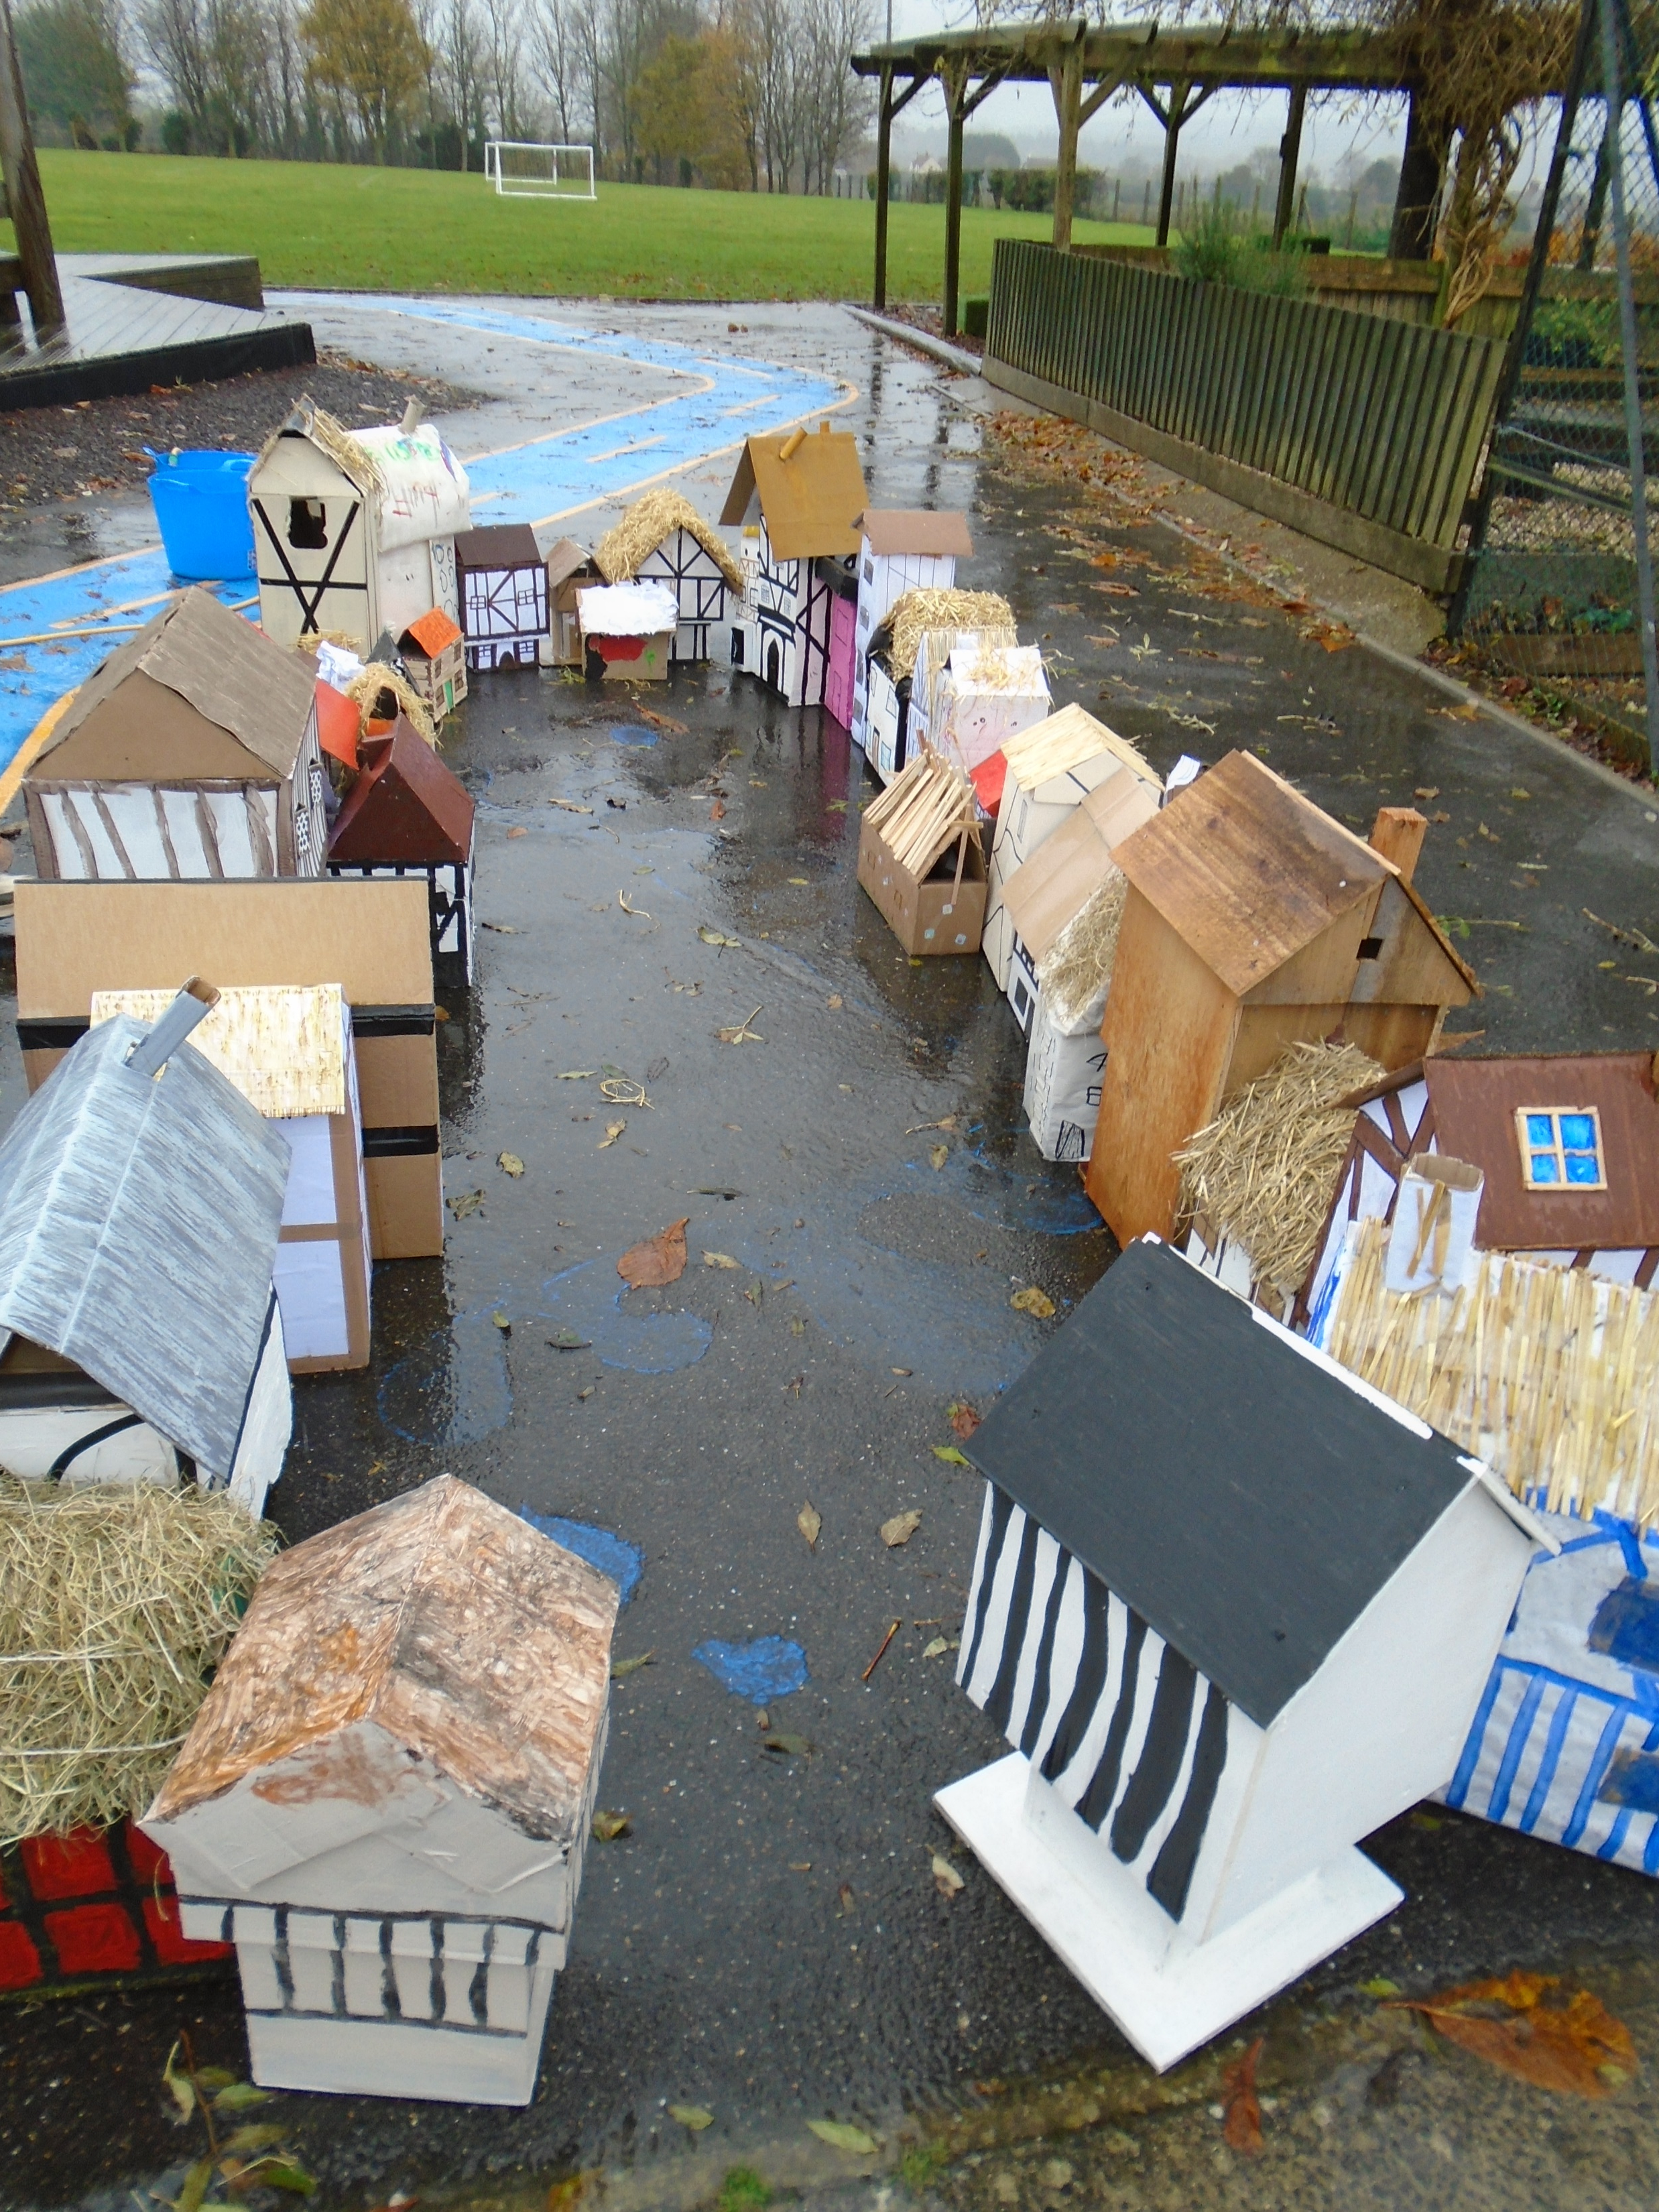
7. Extra Curricular
Trips
Local walks
Special days in school
Visitors in school
Volunteers

Slide 12
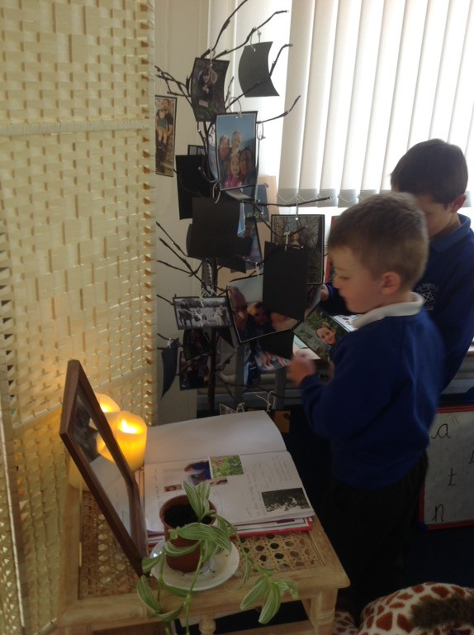
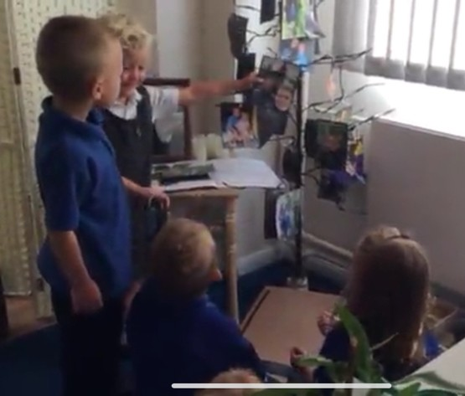
8. Family photos
Throughout the year, we will ask for you to share some photos from home, so that your child can talk about their family and their traditions with each other.
Please provide a family photo when we complete our home visit (or email it to the school). This photo will be displayed for your child’s first day in school so you will be close with them. The photo will be later added to our class photo album in the home corner.
Belonging Tree

Slide 13
Things coming home…
Safe use of internet
Home school agreement
Consent forms

Slide 14
Home Visits
Start of our journey together
Home setting
Return forms (including super me)
Family photo
‘Favourite toy’
Tuesday 28th June Wednesday 29th June Thursday 30th June

Slide 15
Nursery Visits
Seeing children in their learning setting
Please give consent, whilst signing up to a home visit with Mrs Regan
SEND difficulties or concerns

Slide 16
Important Dates!
Thursday 7th July 9:15 – 10:15 am | Stay and Play with Parent An opportunity to explore the learning environment together.
Thursday 14th July 9:15 – 10:15am | Stay and Play without Parents Please drop your child off at the school office where you will be greeted by a member of staff as well as Year 6 buddies.
Thurs 1st & Friday 2nd September | INSET (Staff Training Days)
Monday 5th September | All Reception pupils in school from 9am – 11:45am
Tuesday 6th September | All Reception pupils in school from 9am – 11:45am
Wednesday 7th September | All Reception pupils in school from 8:45am – 1:15pm (either book hot meal or packed lunch)
Thursday 8th September | All Reception pupils in school from 8:45am – 1:15pm (either book hot meal or packed lunch)
Friday 9th September | All Reception pupils in school from 8:45am – 3:00pm (either book hot meal or packed lunch)
From Monday 12th September | All Reception pupils in school full time from 8:45am – 3:30pm
Tuesday 20th September | Parent Information Evening

Slide 17
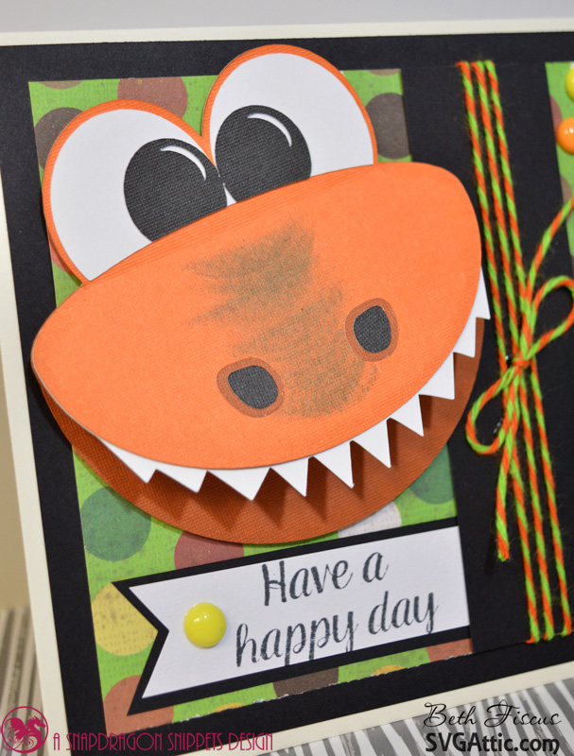
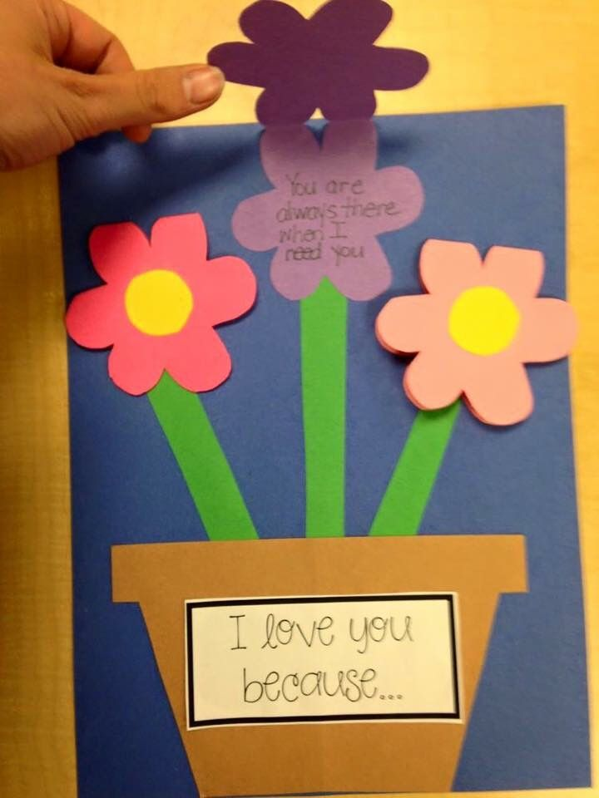
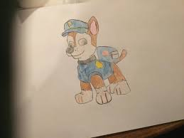
Shhh… top secret!
Library

