Slide 1
Meet the Teacher
Mr Grant-Peterkin

Slide 2
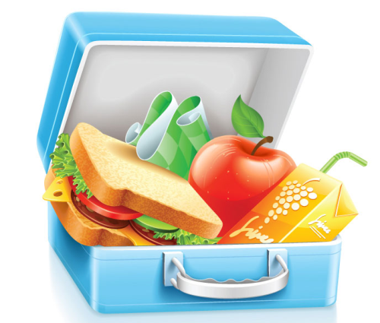
Lunches, Snacks and Water
Healthy lunch boxes are A MUST!
Fruit can be brought in as a snack for break times.
Water is provided in the classroom, if the children need a drink. They are encouraged to keep well hydrated.

Slide 3
Home Learning
Home learning will be given weekly with a focus on Maths and spellings.
Children will also be given a project to complete in the Autumn and Spring term. This term’s project will be sent out on: TBC
Year 6 children will be given specific home learning in the weeks before the National Tests.

Slide 4
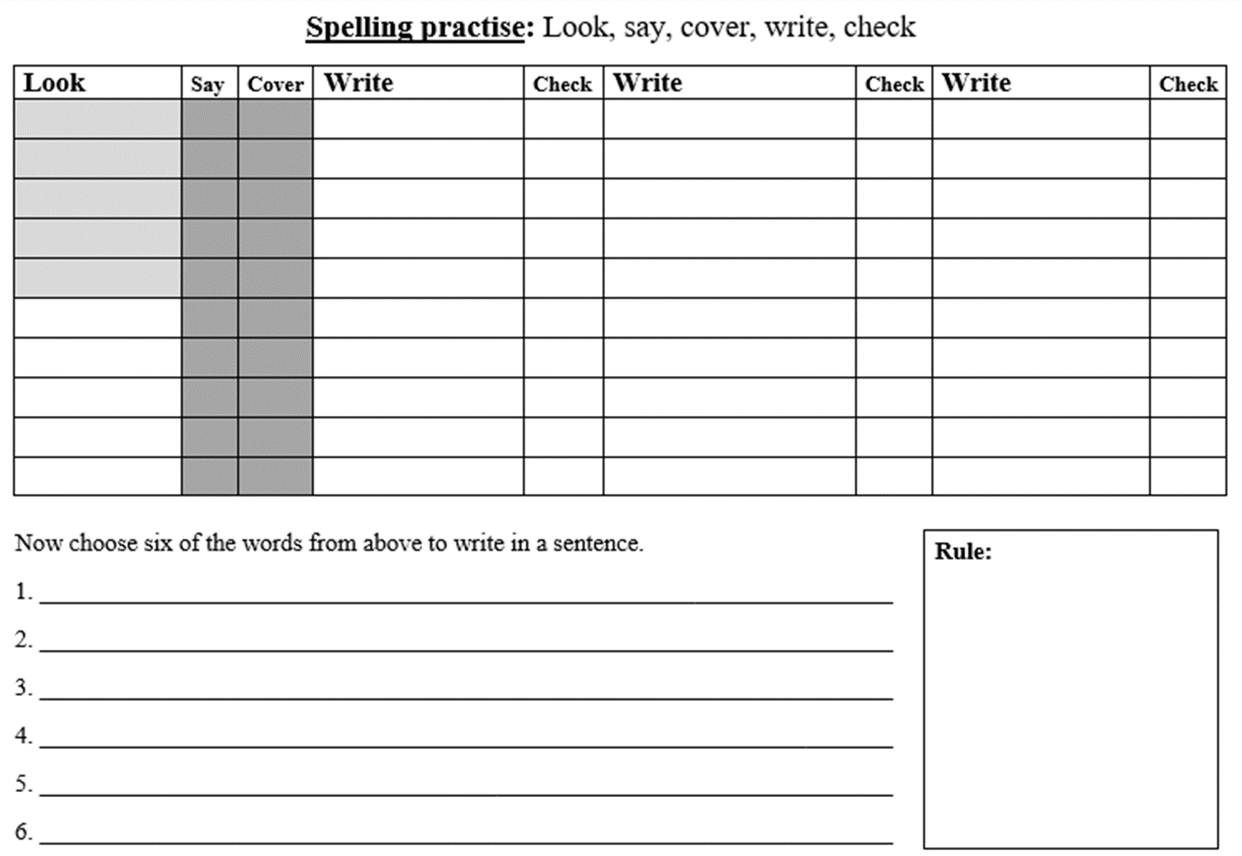
Spellings
Handed out on Monday.
Handed in on Friday morning.
Test Friday afternoon.
THINK and REFLECT for spelling sheet not handed in
completed on Friday morning.

Slide 5
English and Maths
Handed out on Friday afternoon.
Handed in on Tuesday morning.
THINK and REFLECT for homework not handed in completed Tuesday morning.

Slide 6
Home Learning Check
Monday lunch break, bring home learning to school if struggling and need help.
This qualifies you for…
Home Learning Club
Tuesday lunch break, bring home learning to complete.
Only eligible for club if you brought to school your home learning for help on Monday.
THINK and REFLECT for homework not handed in completed Tuesday morning.

Slide 7
PE
Sapphires will be having PE lessons twice each week, on Monday afternoons and Friday morning.
Please make sure they have appropriate PE kits in school each day as there are a variety of clubs where the children require their kit, including trainers.

Slide 8
Topic
Marvellous Maps.
Magnificent Mountains.
Science
Living Things and Their Habitats

Slide 9
Reading
Your child will learn HOW to read during Guided Reading sessions in class. They will be using the Reading VIPERS to help guide their questioning.
These are skills which can then be practised at home when reading with parents. The VIPERS can be found on pages 7, 8 and 9 of your child's reading record.
We will have our Reading Award Scheme running. So please encourage your children to read independently and with you. We want children to enjoy reading and sharing books with others!

Slide 10
Maths Fluency
Each morning every child practice what they have learnt during Maths Fluency.
10 minutes of daily mental maths and times tables practice up to 12x and the division facts (by the end of Y4, children should know all of their times tables confidently)
Times Table Rock Stars (TT Rock Stars). Please encourage your children to use this programme at home.

Slide 11
Rewards and Sanctions
Everybody at All Saints believes in praising
positive behaviour and hard work!
Certificates in Achievement Assembly
Stickers which go towards our Achievement Award Stars
Reflect and Think
Class Charter

Slide 12
Tuck Shop
Tuck Shop will be on Thursday playtimes and is a fantastic fund raiser for our residential trips. Tuck costs 30p per item.
Donations of cakes, biscuits etc. are kindly appreciated.
There is a rota to help
share the load.

Slide 13
General Reminders
Uniform (coat, PE kit, book bag)
Names in clothes
School starts promptly at 8:55am with registration and maths fluency.

Slide 14
Chromebooks
Each child in Sapphires will have their own Chromebook for the year.
Research, collaborate and program
Use google tools to create: documents, slides, websites and spread sheets.
Receive teaching input and feedback through Google for Education.

Slide 15
Chromebooks
Google classroom
Google homework

Slide 16
Any questions?

