Slide 1
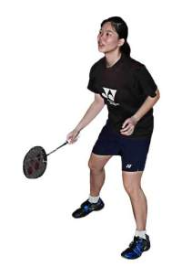
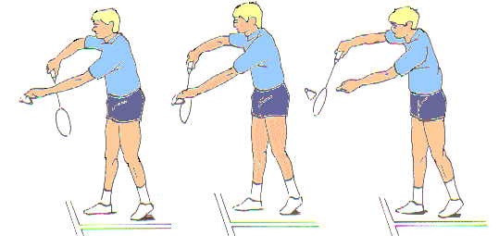


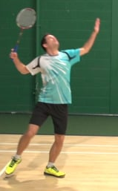
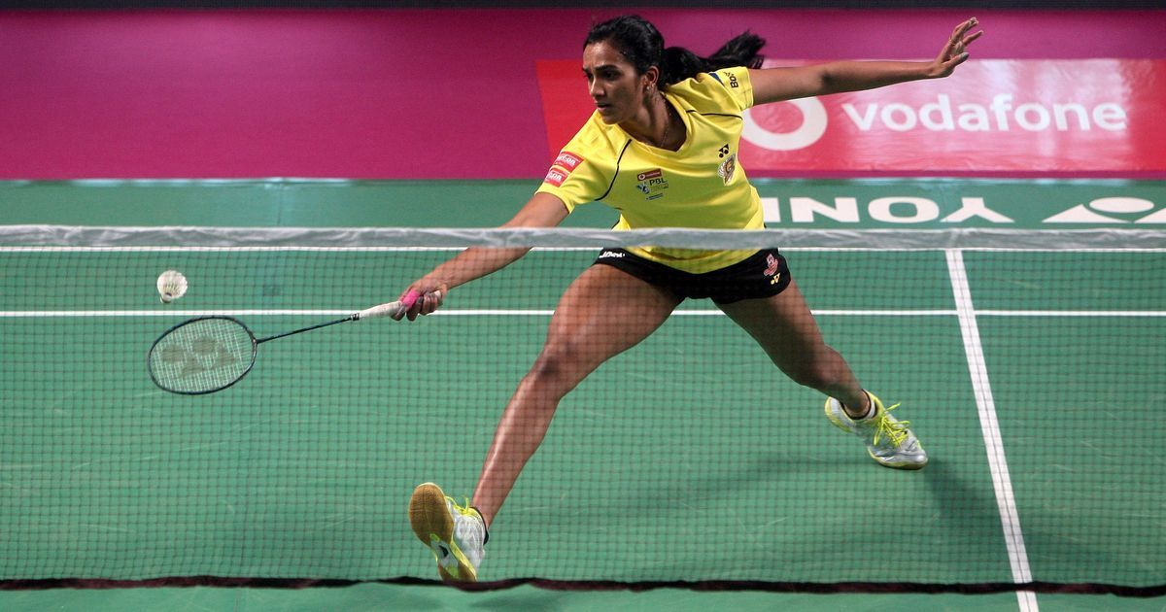
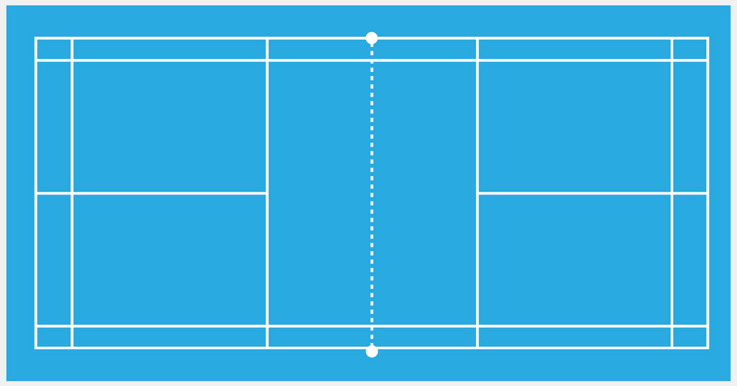
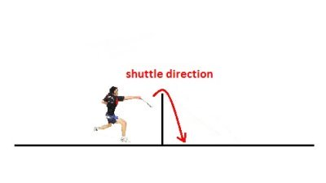
What is the ready position?
Knees slightly bent so to push off either leg quickly Keep your eyes on the shuttle Racquet held correctly, ready to move Bounce on your toes to help give more power
Keywords
Key word Definition
Rally | Working with your partner to hit the shuttle back and forth over the net
Service line | The line on the court you have to stand behind to take the serve
Serve | A shot used to start the game and to start every point.
Recover | Moving back to the middle of the court after each shot to get yourself in the best position for the next shot
The serve
The serve is used to start a game and at the start of every point. An effective serve can help you win the point and make it harder for the opposition to return the shuttle. Hold the shuttle in your left hand, pinching it with you finger and thumb Take your racquet hand back behind your hand and strike the shuttle Hit the shuttle over the net to your opponents side of the court
Making contact with the shuttle
Once you are in the ready position, you now need to make contact with the shuttle. Keep your eyes on the shuttle- try not to let the shuttle go behind you If the shuttle is high, use an overhead shot If the shuttle is low, use an underarm shot Overhead shot Underarm shot
Rubies Autumn 2022
Badminton
Overhead clear
The overhead clear is used when the shuttle comes high over the net. To perform the over head clear you need to: Stand in a sideways on position Create the Usain Bolt pose Strike the shuttle at the highest point and follow through
Bay
Dropshot
The dropshot is used to score a point if you opponent is at the back of the court. It can be done by either the underarm or overhead shot but you need to slow your racquet down before you hit the shuttle. This allows the shuttle to land as close to the net as possible
Soft rock
Hard rock
Headland

