Slide 1
Eco Committee worship 30/09/21

Slide 2
Eco Committee Who is your class representative? Meet us!

Slide 3
The Eco Committee vision To encourage the whole school community to protect, explore and appreciate our environment

Slide 4
Recycling 1. try to reuse 2. what can go in our recycling bins in the class room? 3. Tough stuff bin 4. food waste at break and school dinners

Slide 5
Eco committee photo competition 1. autumn theme 2. can be wildlife/ landscapes/ still life 3. free to enter 4. prize for ks1/ ks2 and adults 5. entries in on Thursday 4th November accompanied by an entry form (this gives you half- term)

Slide 6
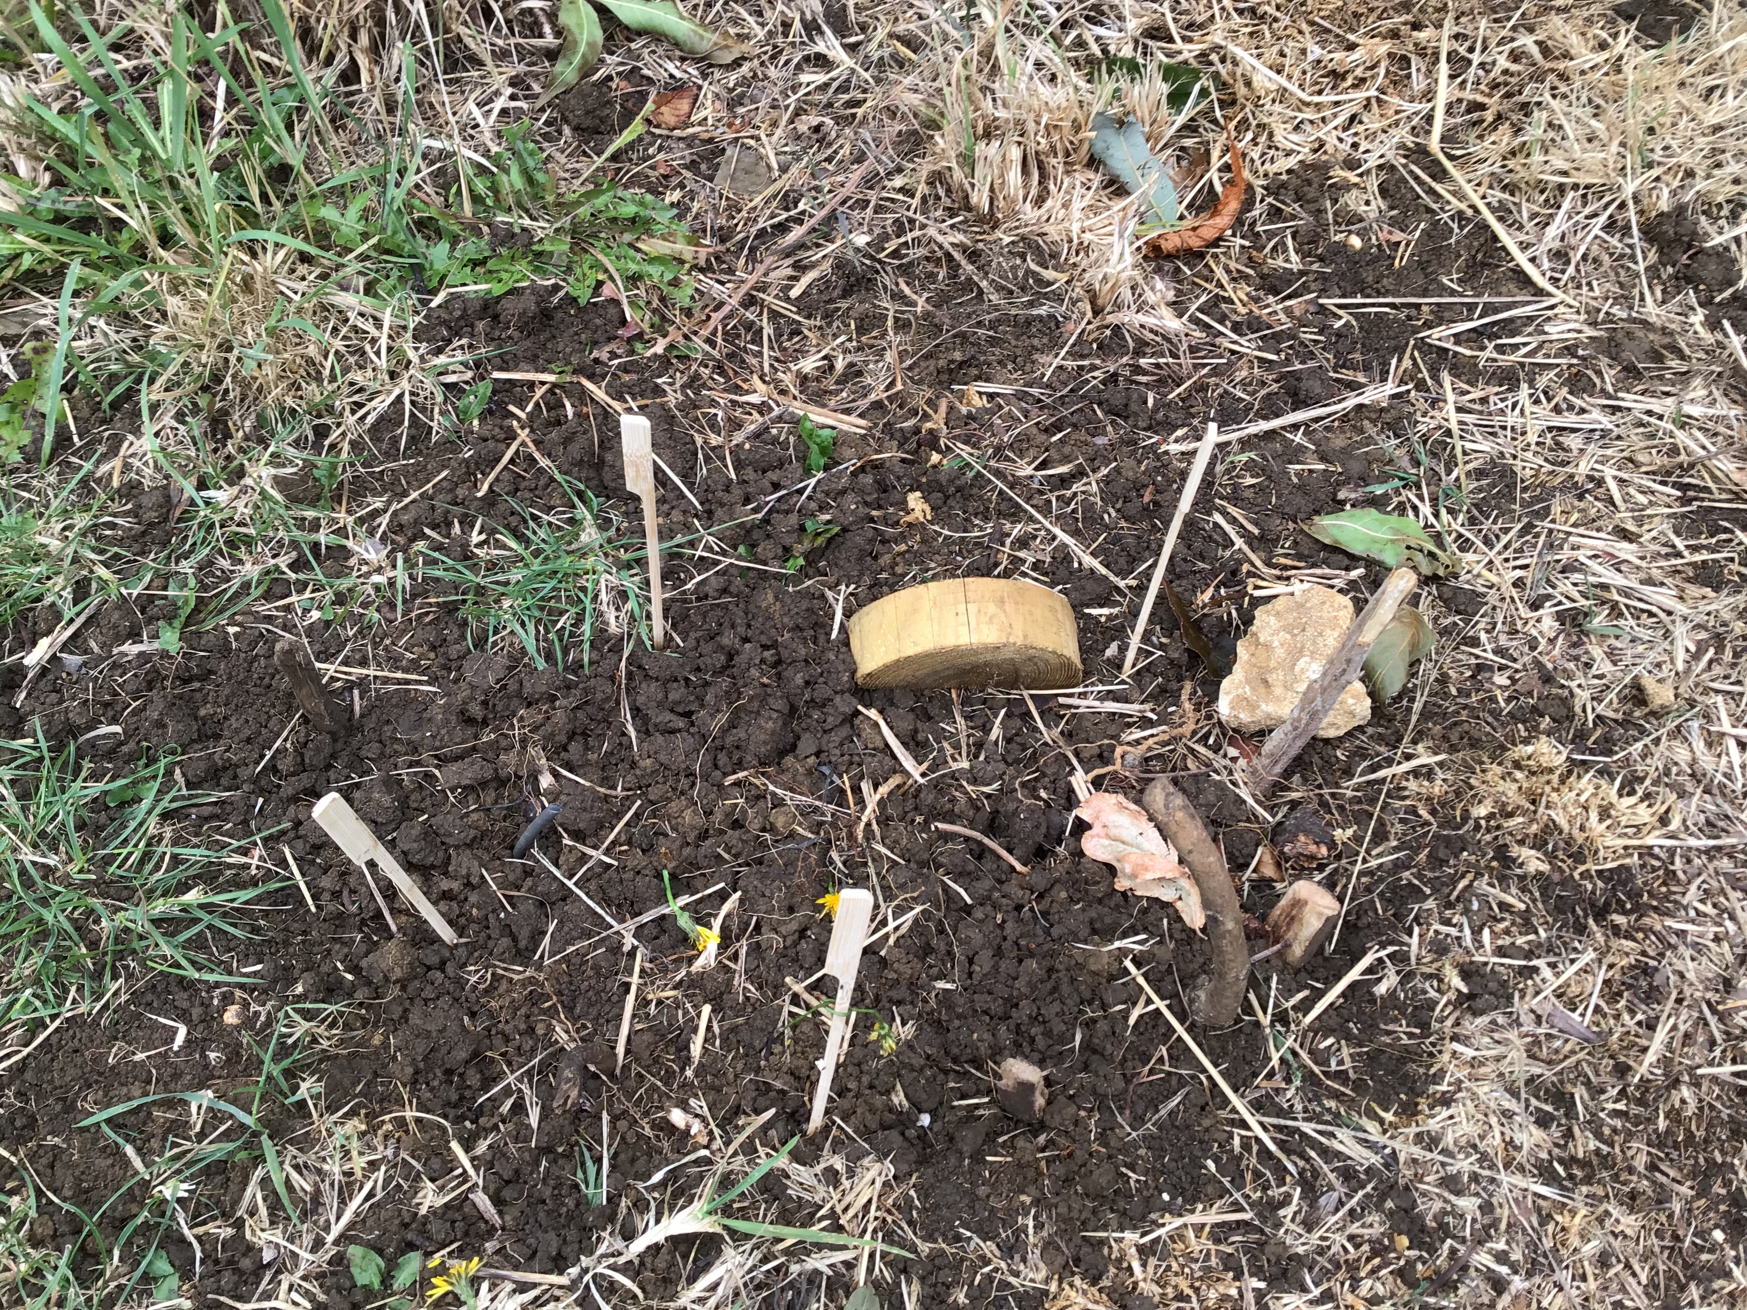
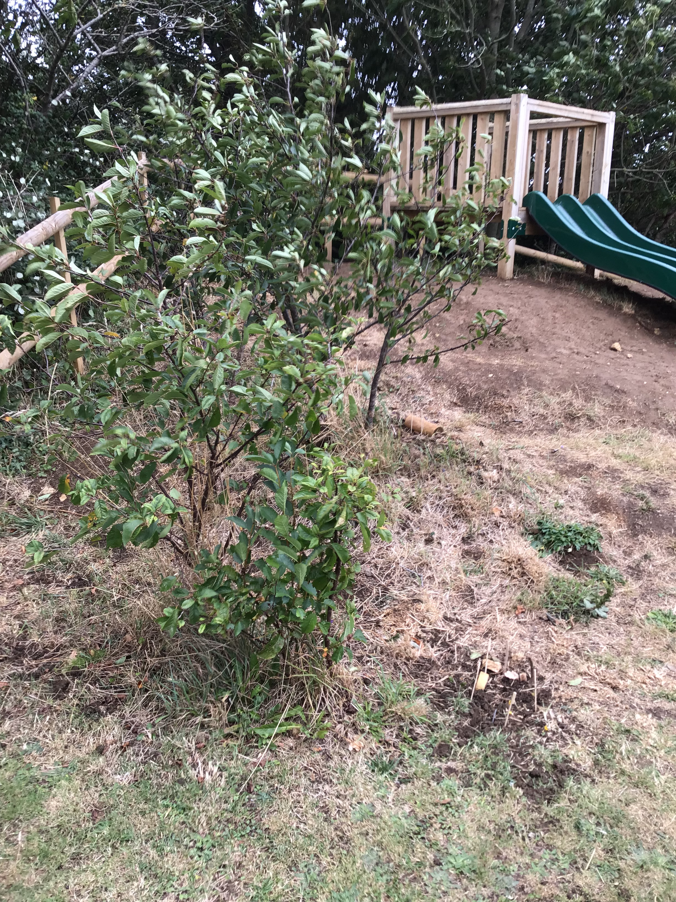
How should we treat plants/ trees and wildlife in our school grounds?

Slide 7
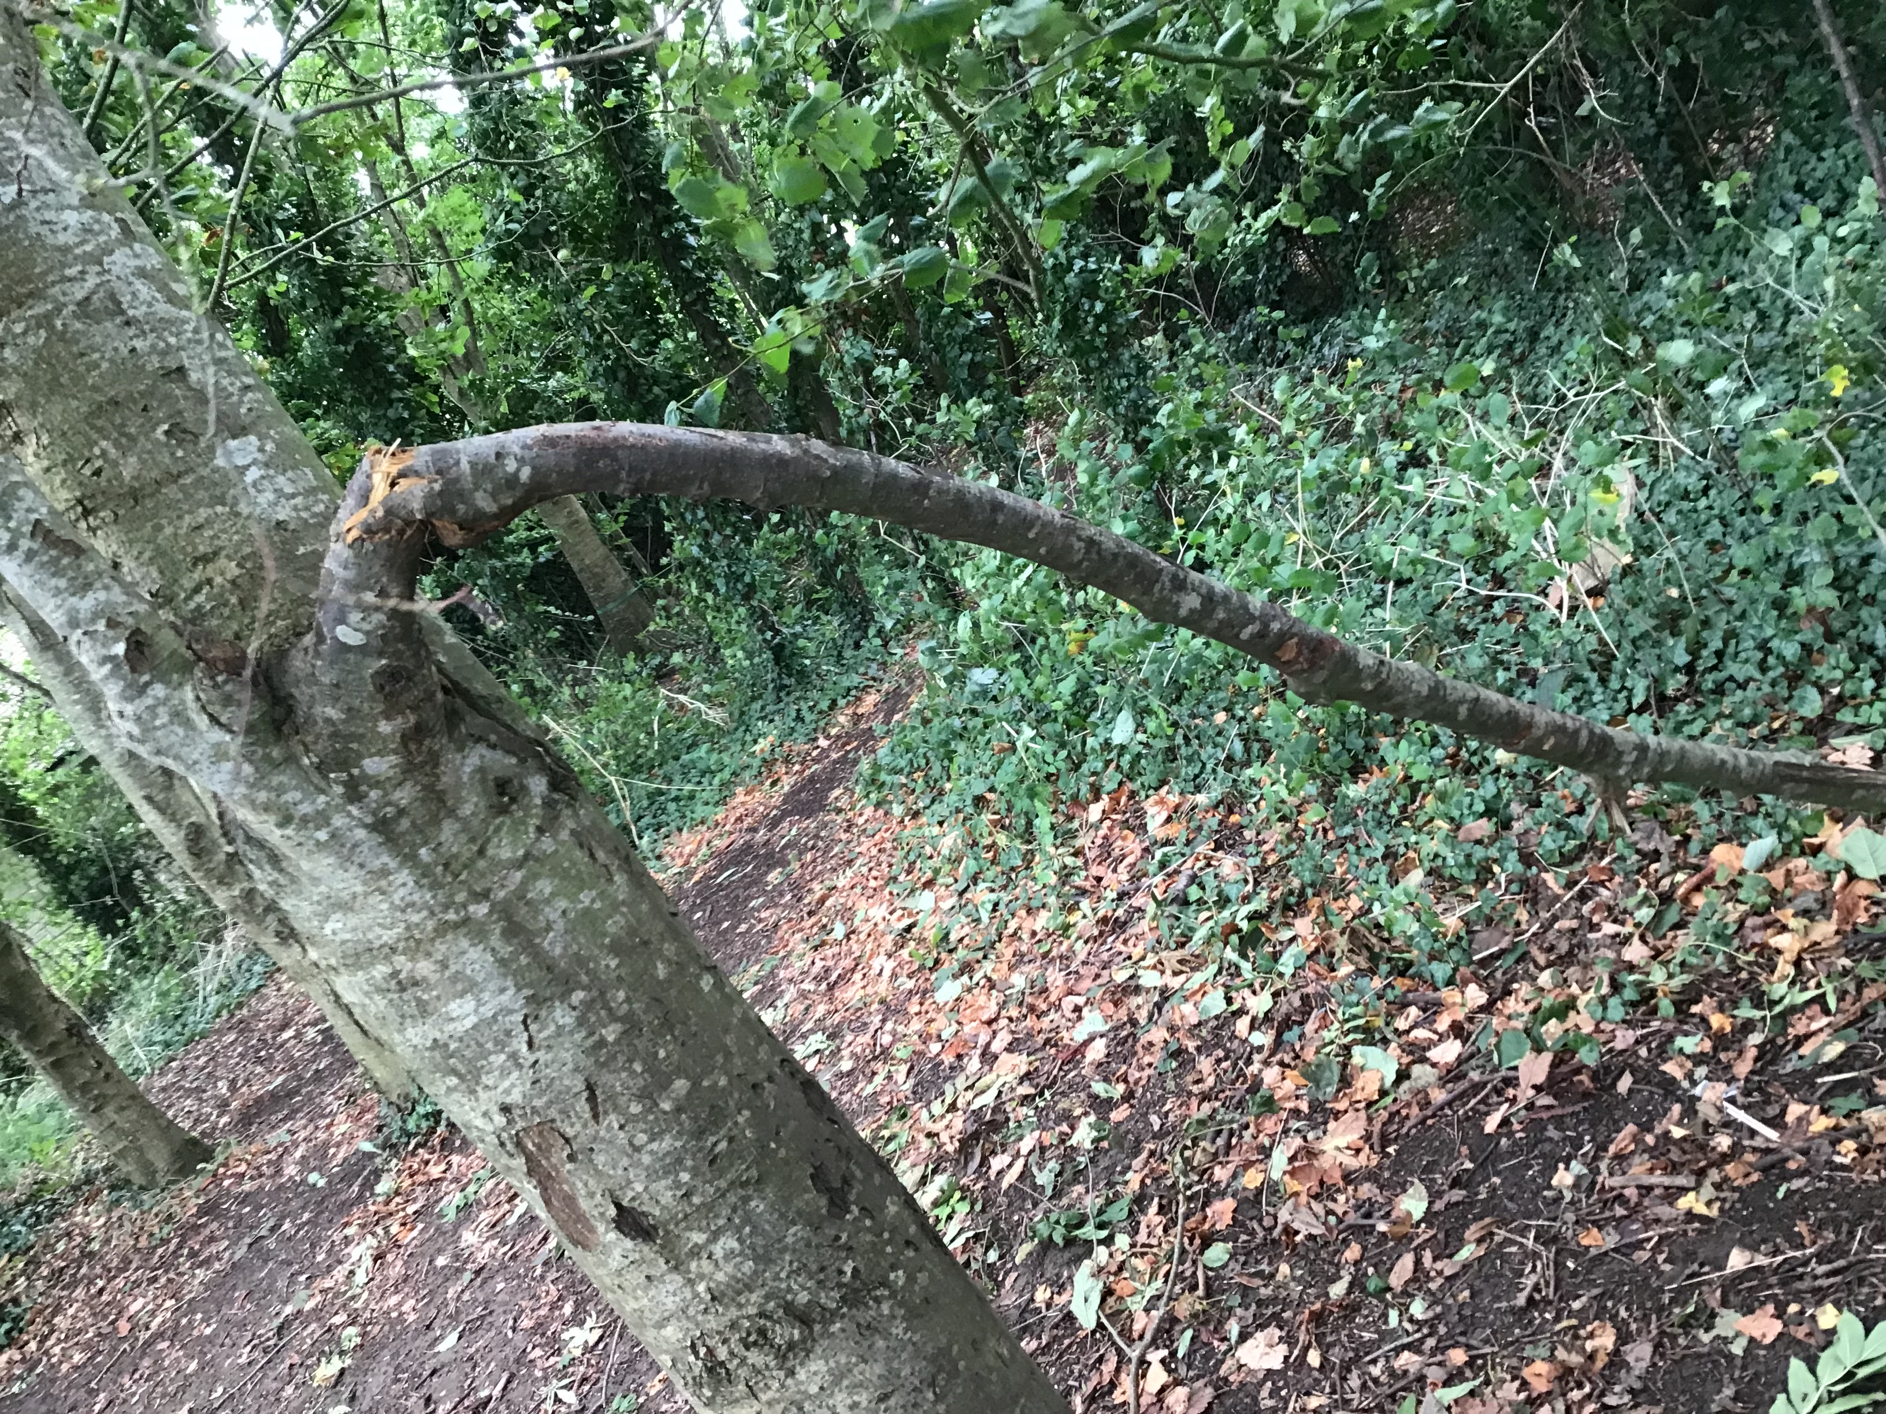
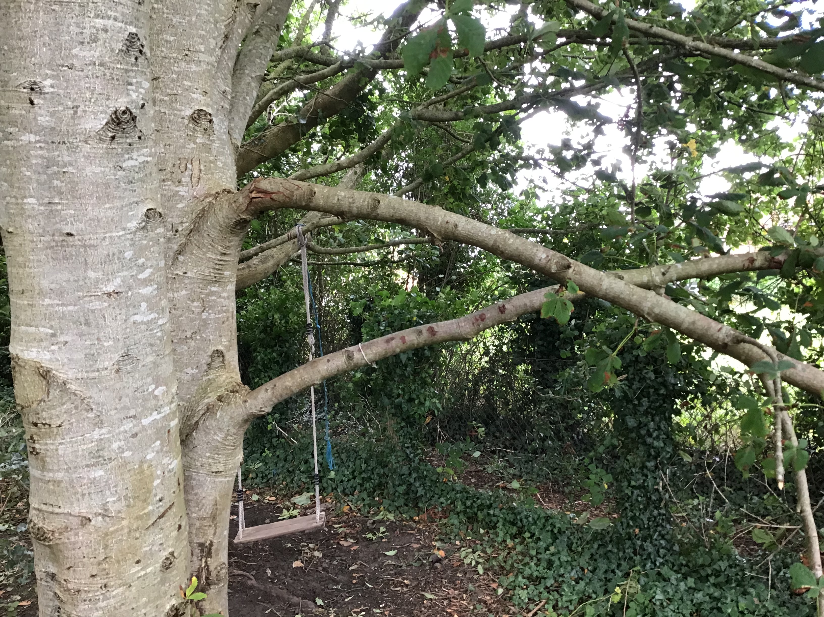
How should we treat plants/ trees and wildlife in our school grounds?

Slide 8
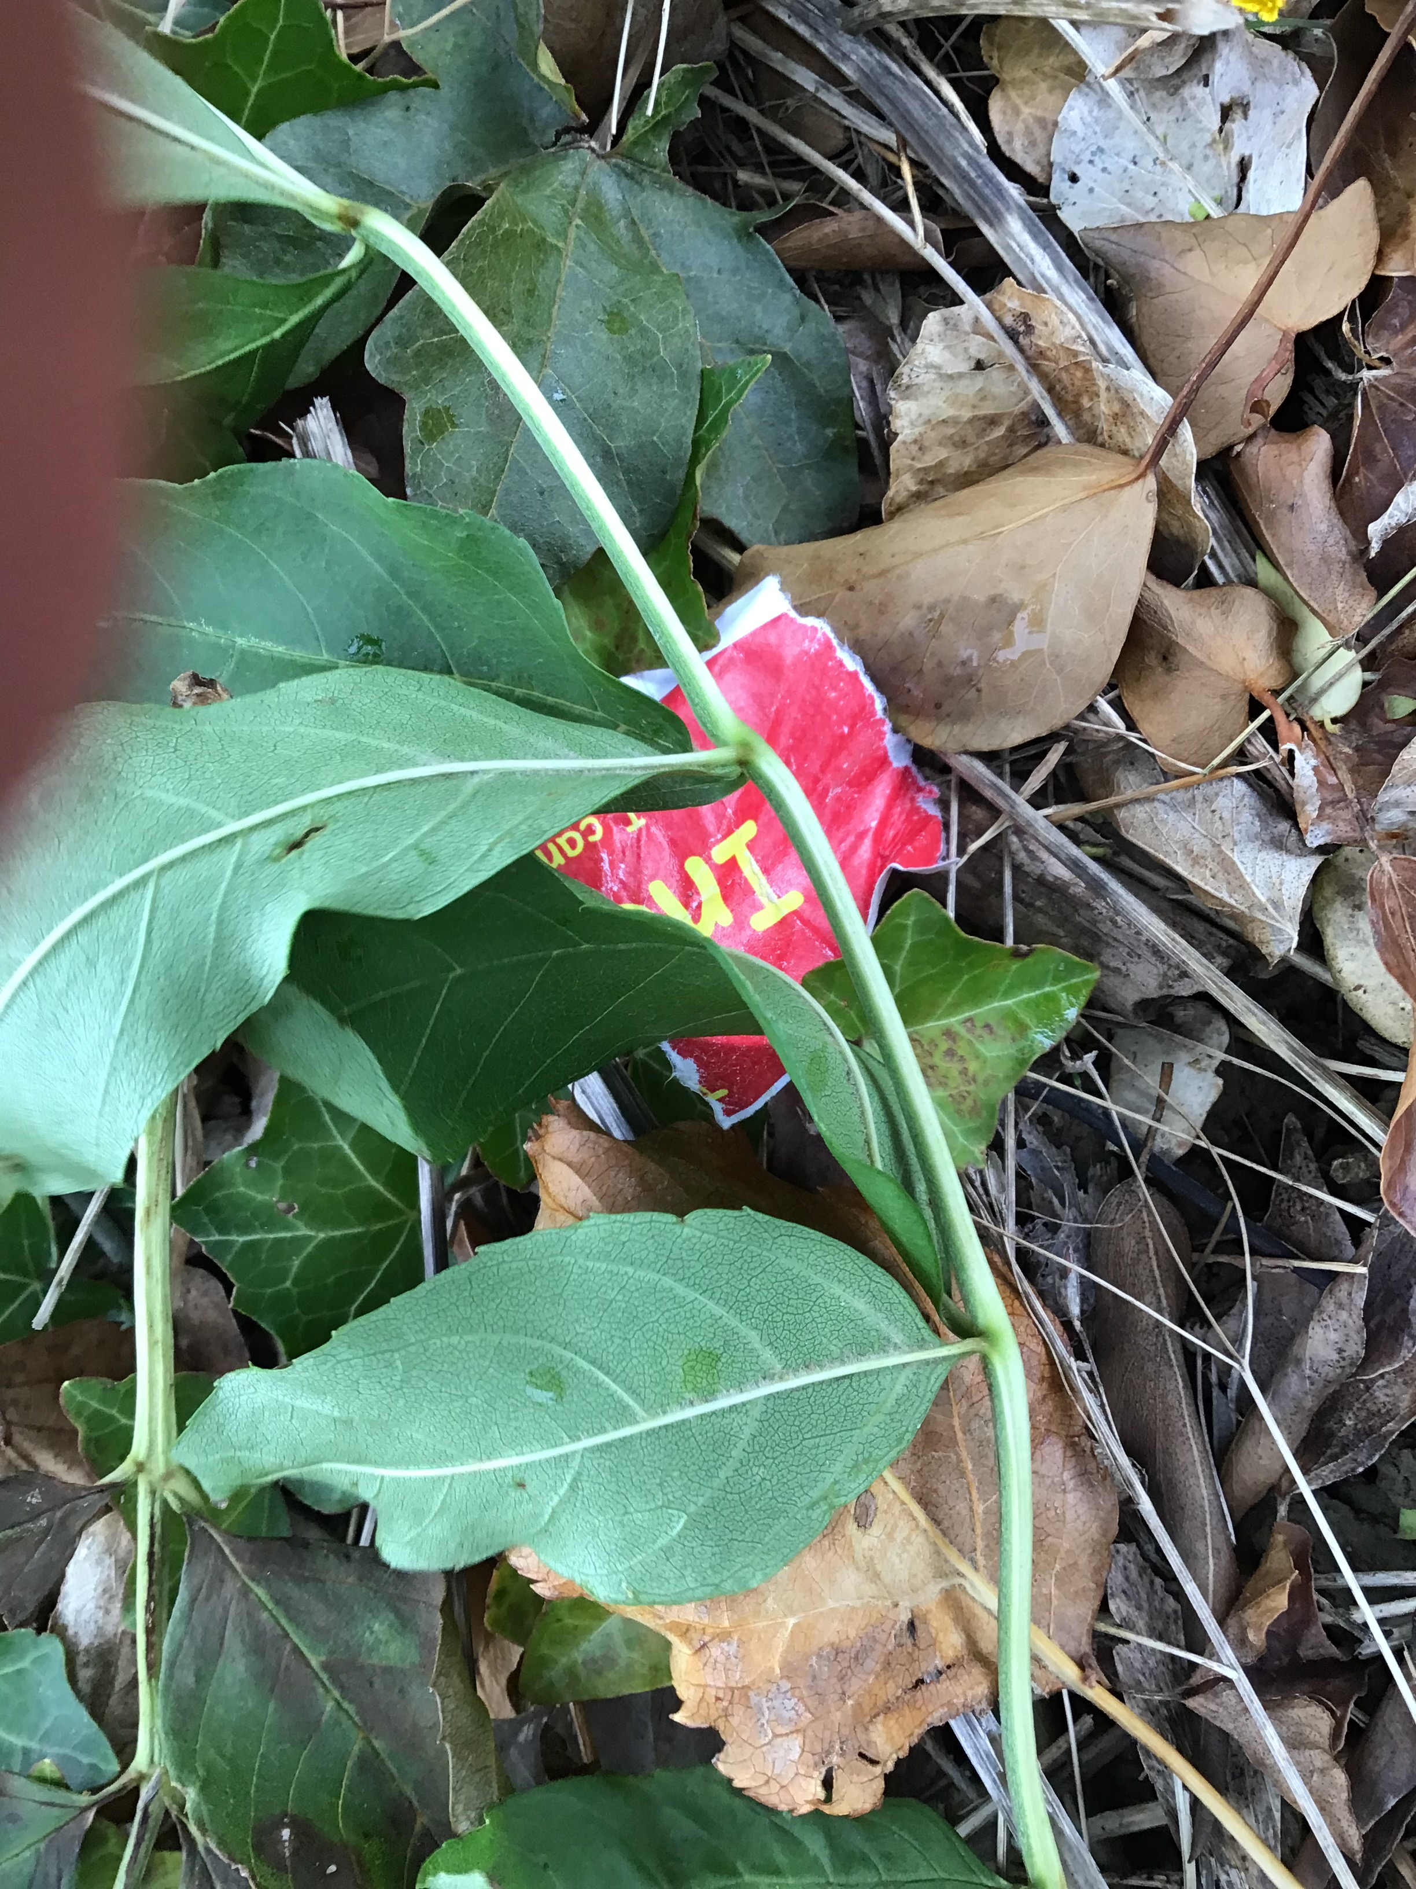
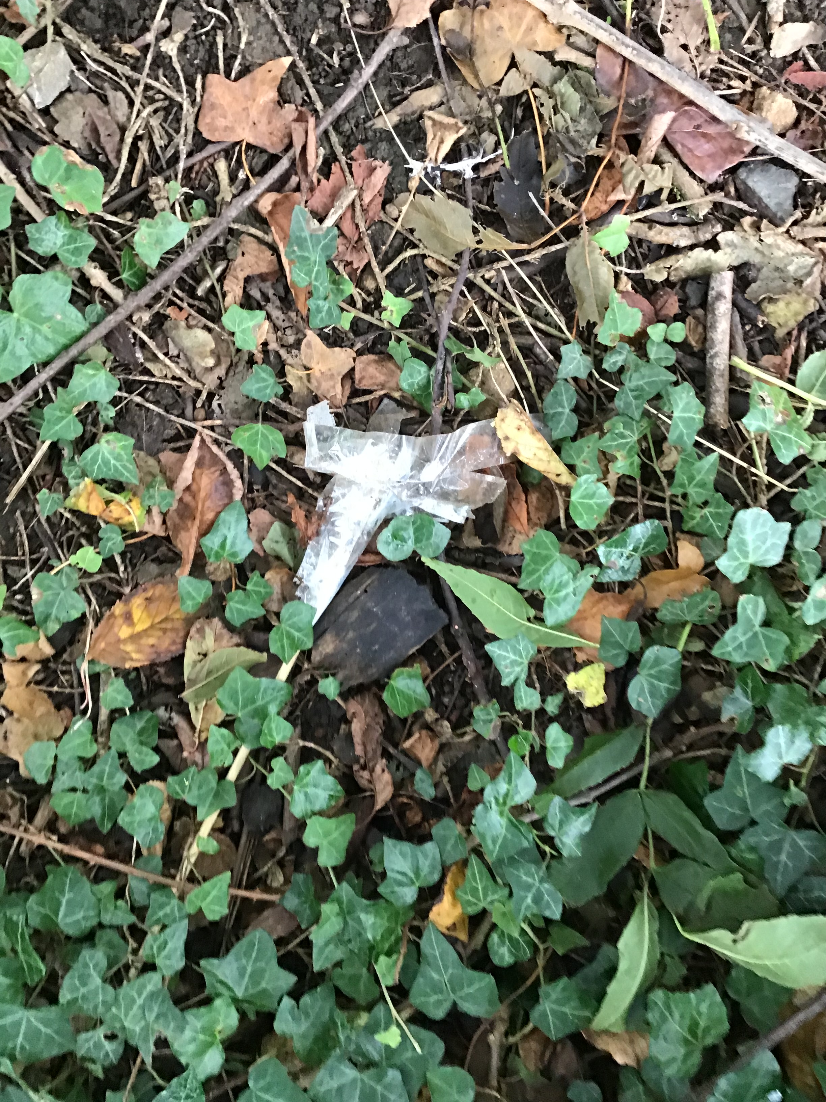
How should we treat plants/ trees and wildlife in our school grounds?

Slide 9
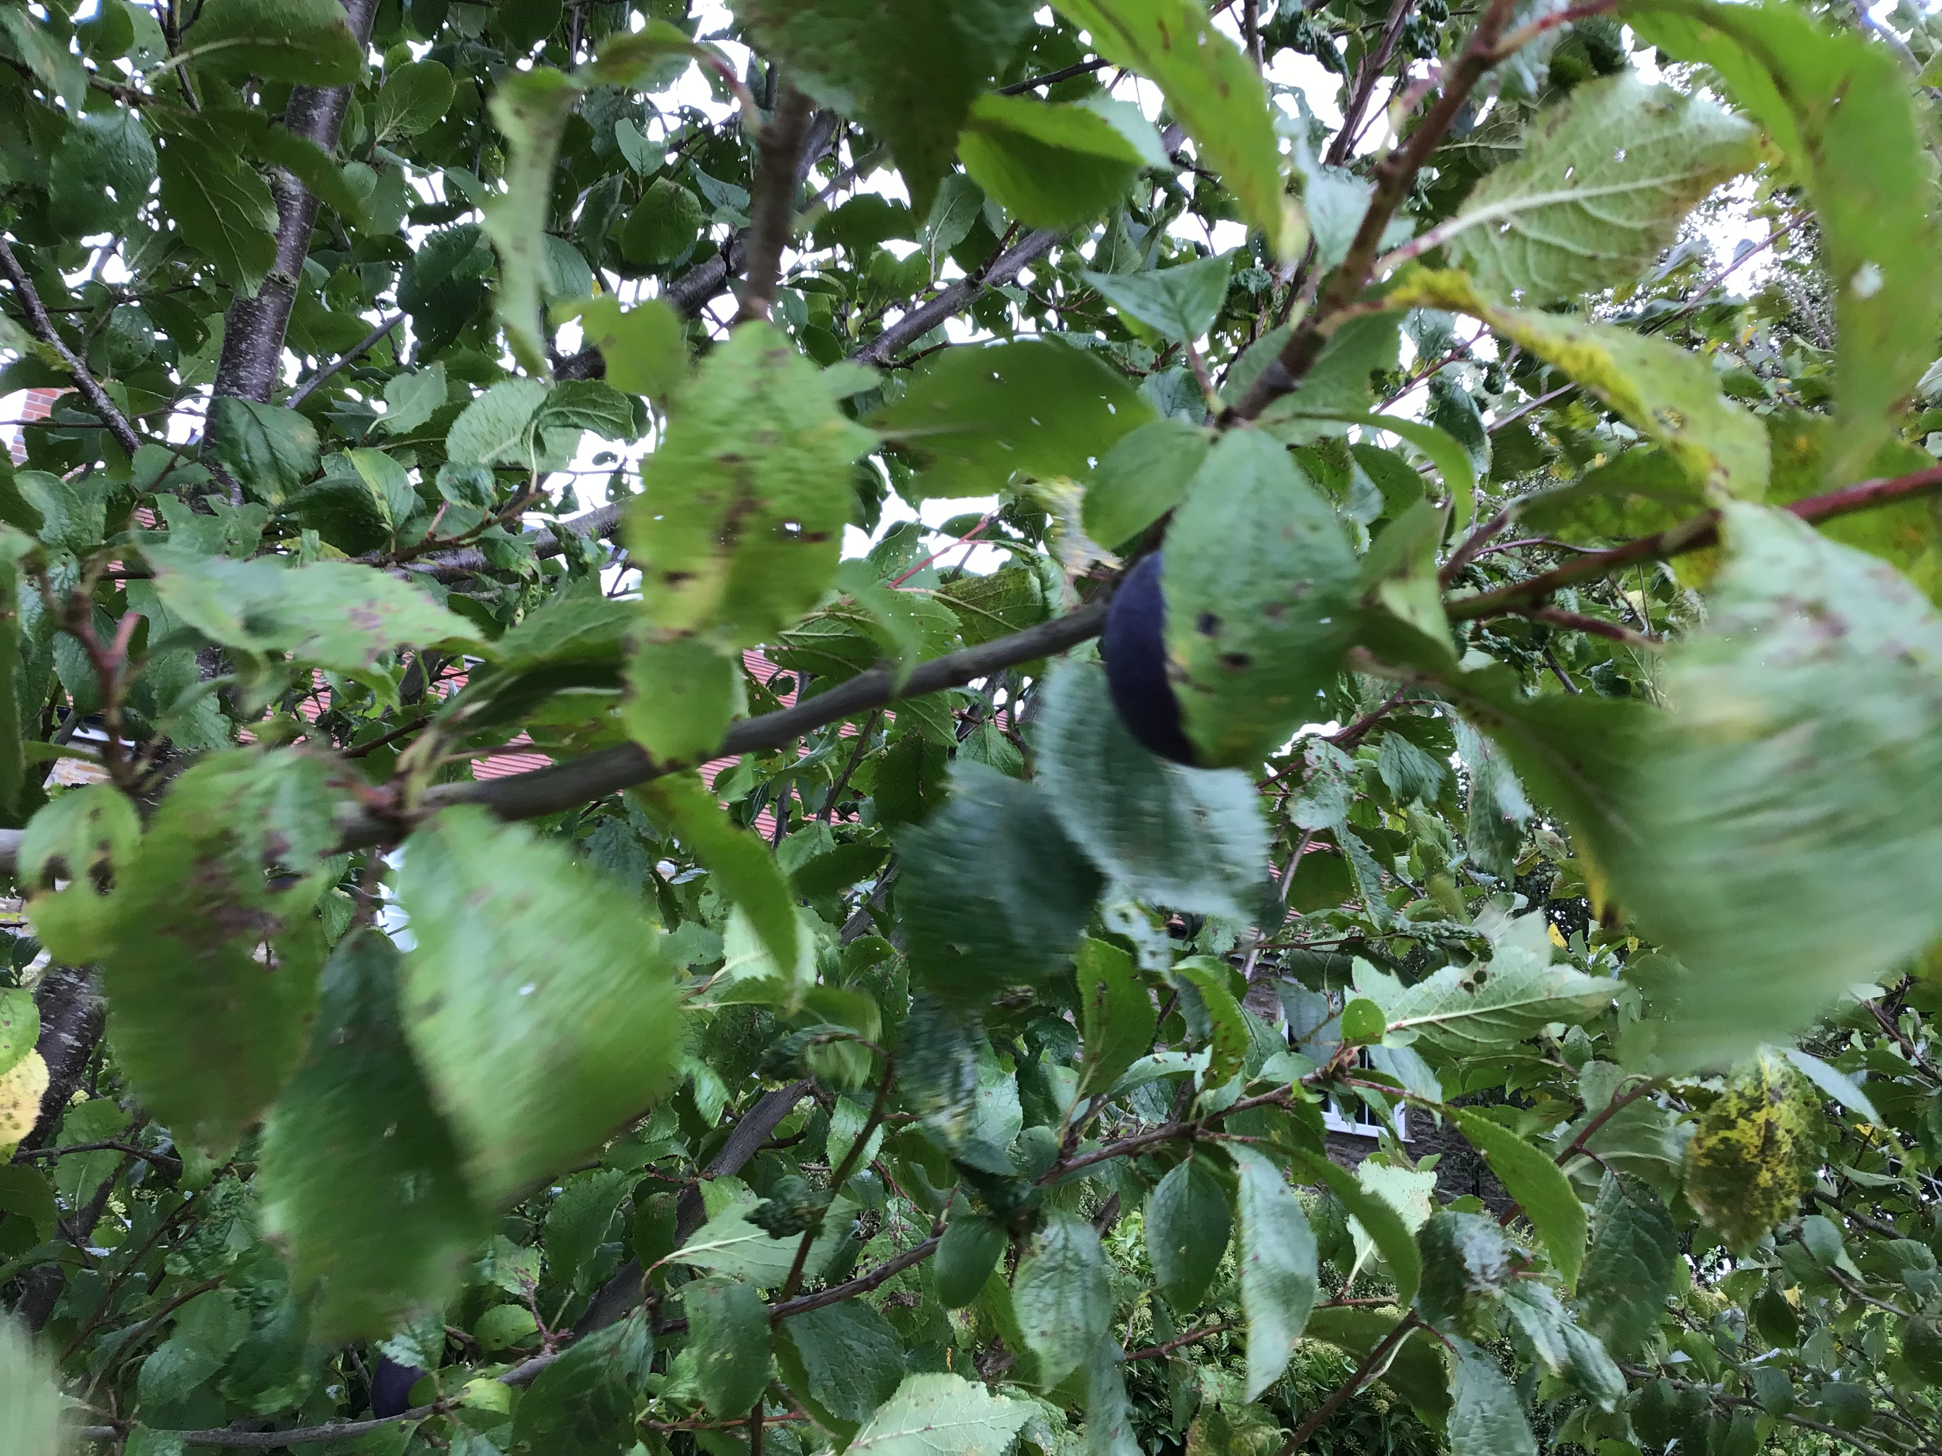
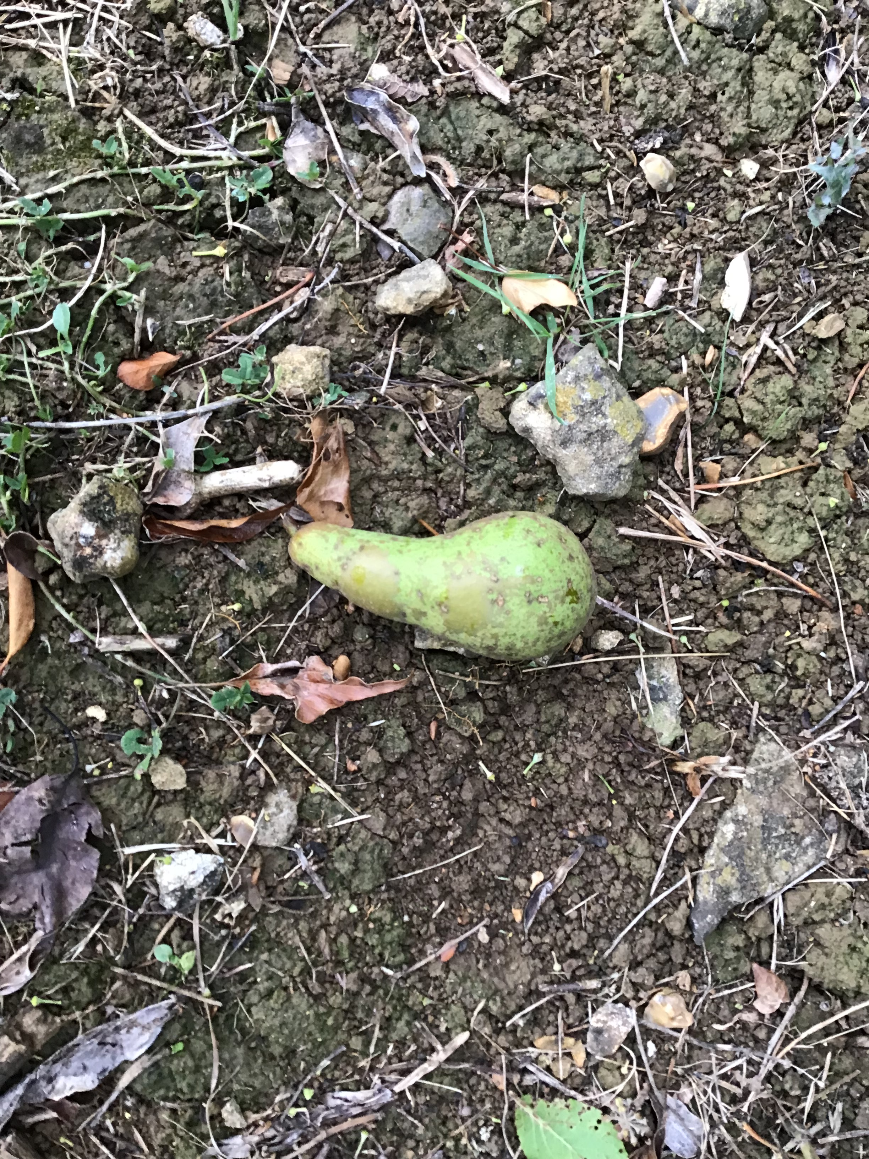
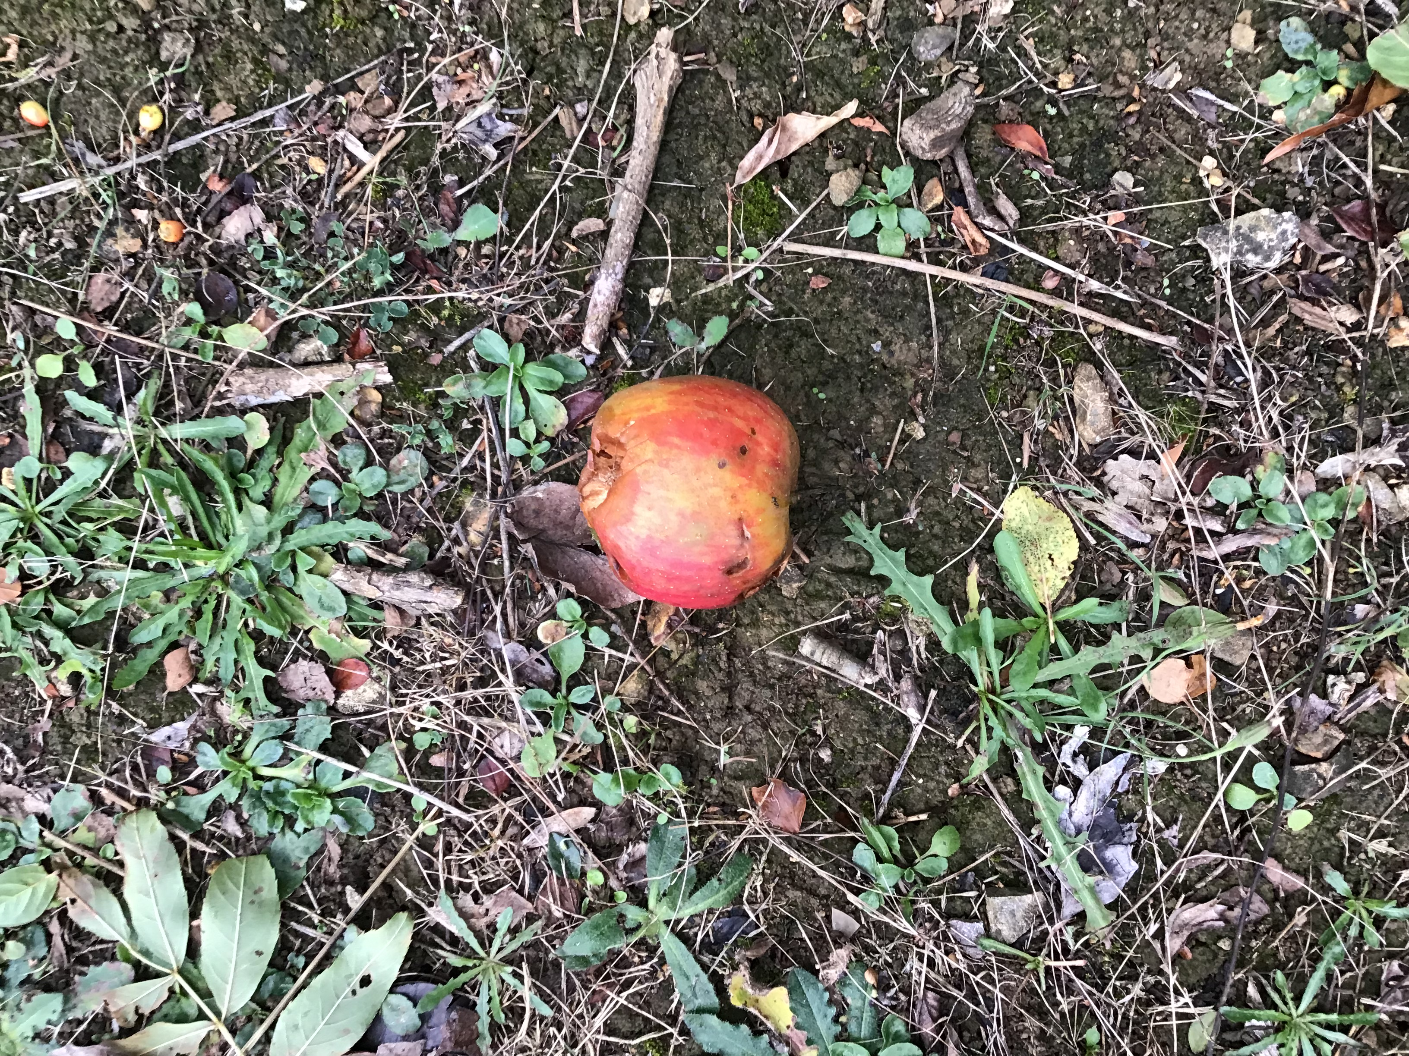
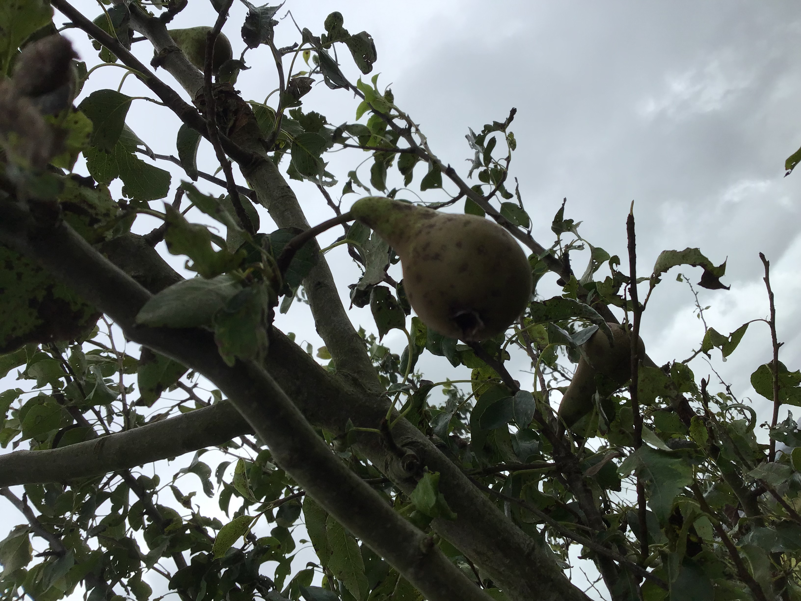
How should we treat plants/ trees and wildlife in our school grounds?

Slide 10
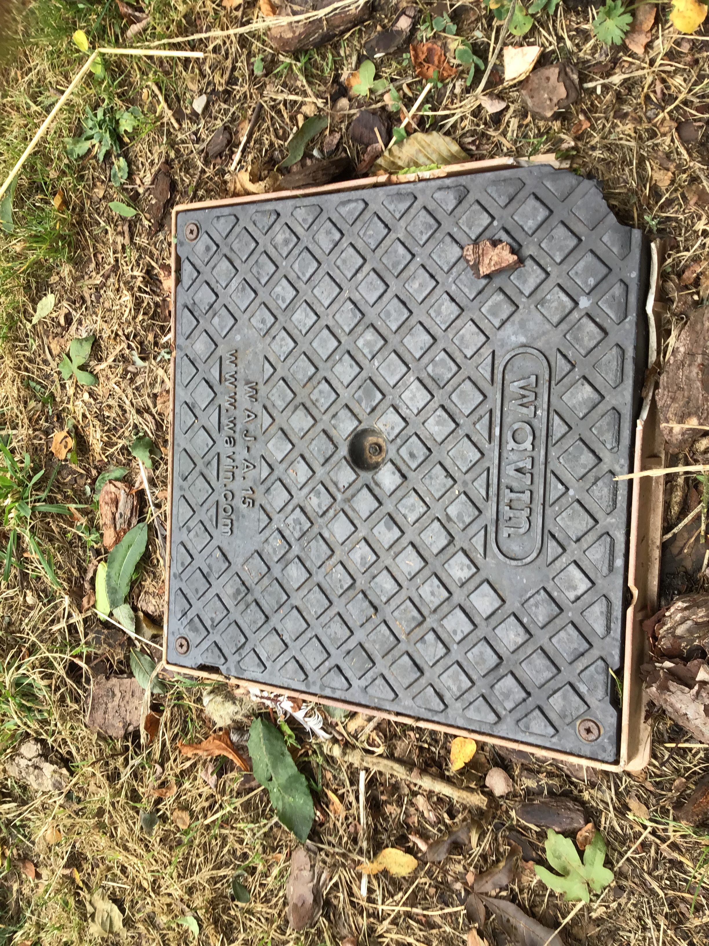
How should we treat plants/ trees and wildlife in our school grounds?

