Slide 1
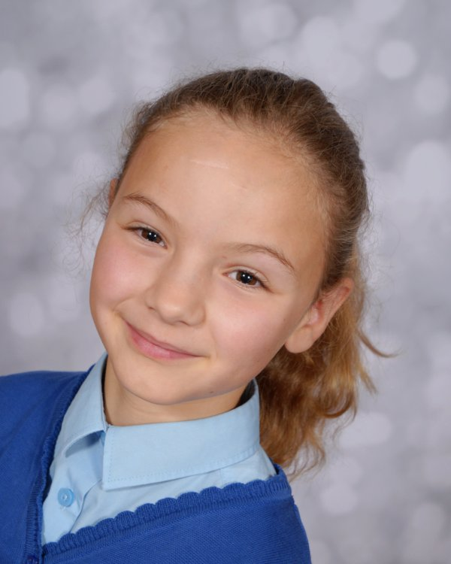
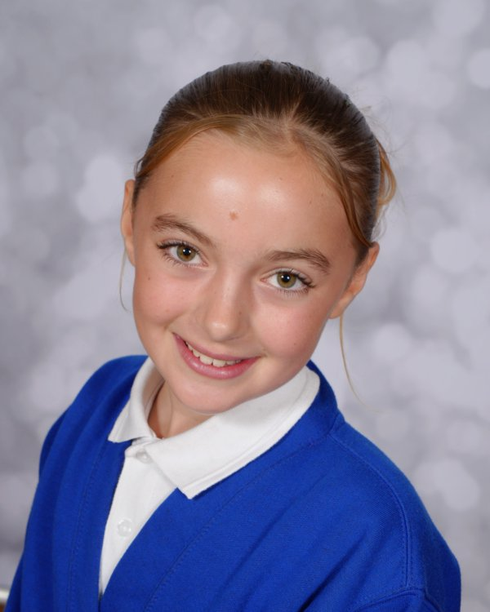
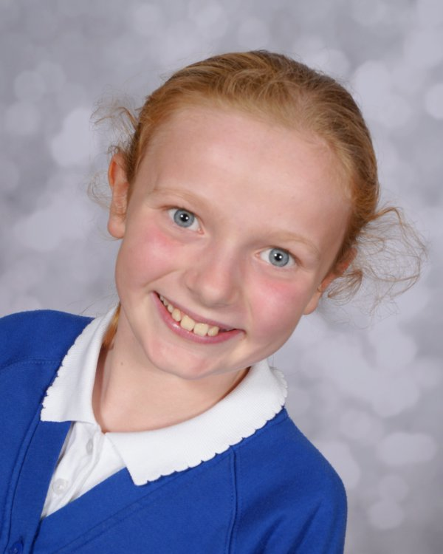
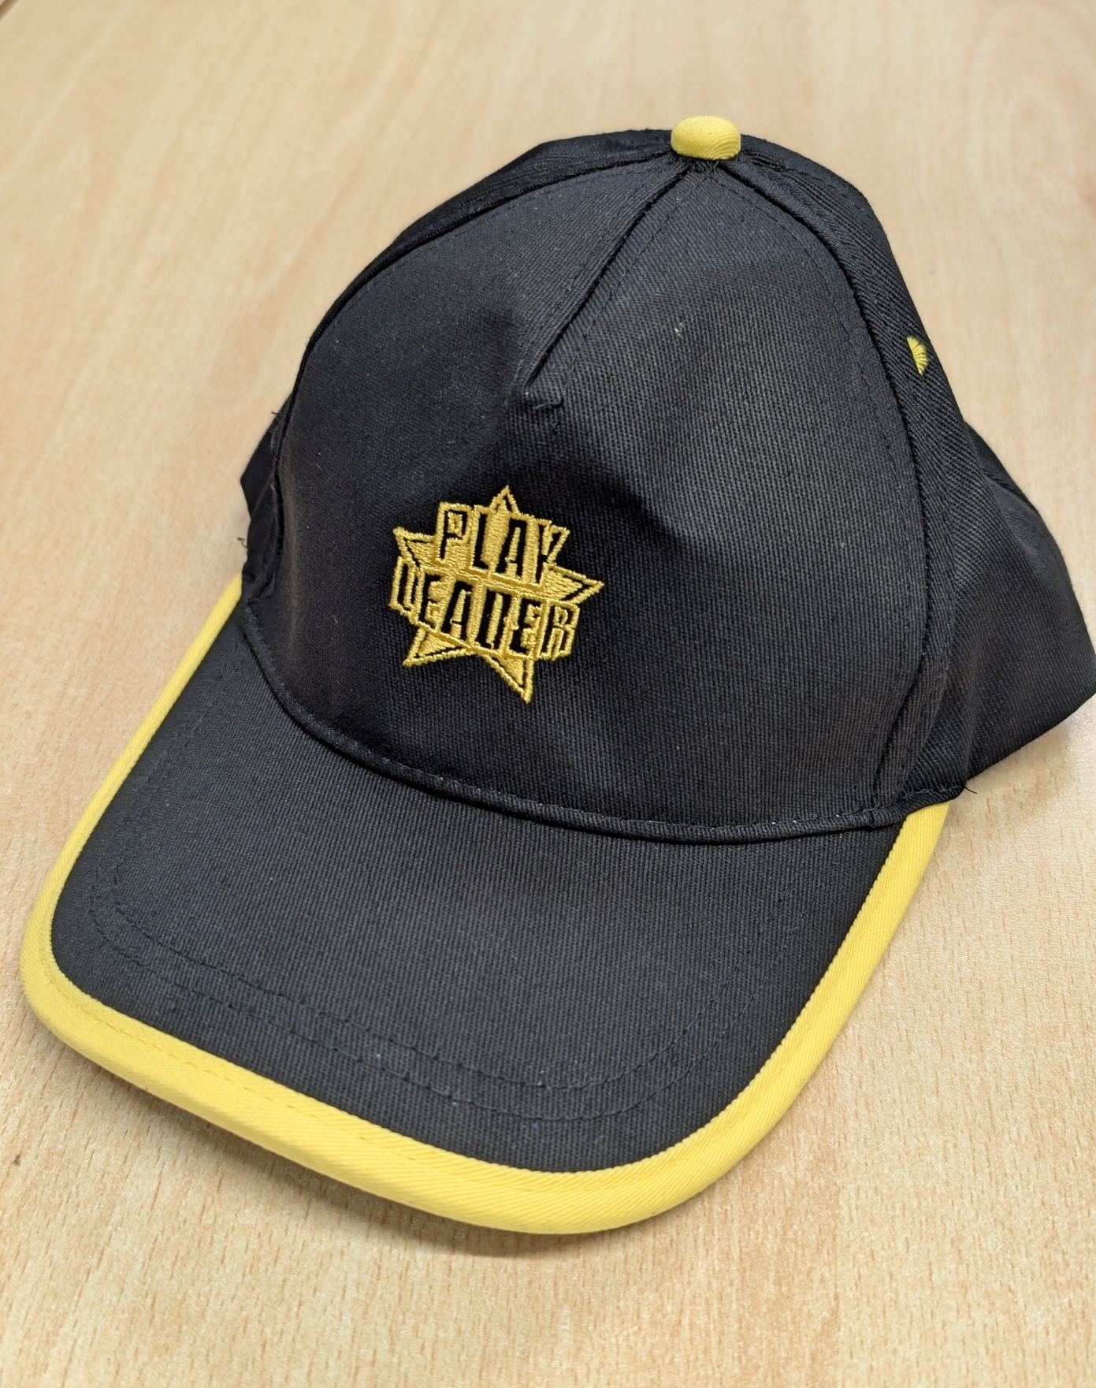
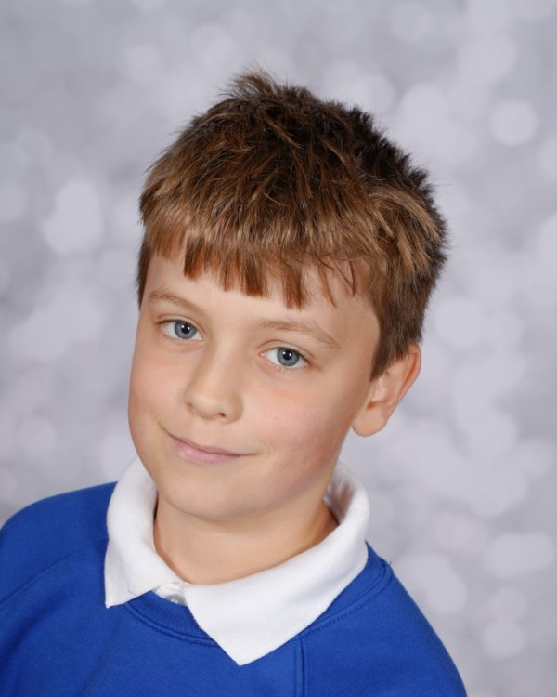
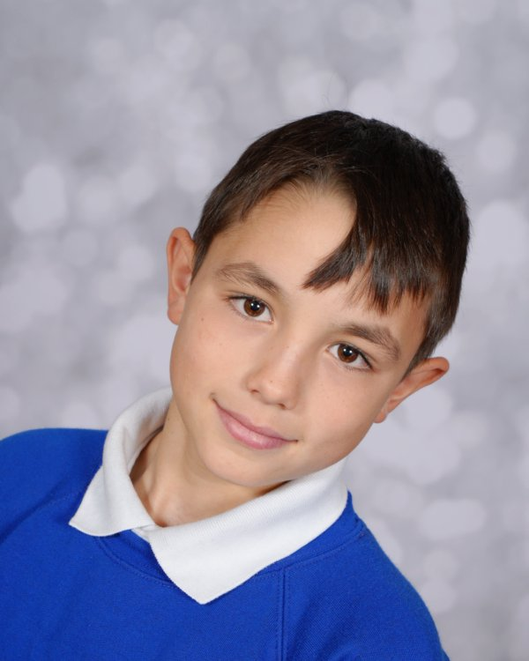
We are here to help you

Slide 2
What is happening at lunchtimes?
Monday | Tuesday | Wednesday | Thursday | Friday
Choir | Cross-country running | Netball 5/6 | Tag rugby | Dodgeball
Netball 3/4 |  | Positivity club
Basketball | Parachute | - | Obstacle course | Target practice
Plus everyday our ambassadors will put out lots of exciting equipment for you to enjoy playing with.
No need to sign up. Just turn up and join in!

Slide 3

Respect and be thankful
Please remember, the Bronze Ambassadors are giving up their lunch time to provide fun activities for you.
Please, remember your school values.

Slide 4
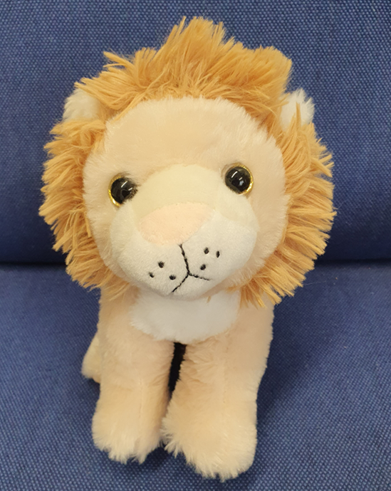
Personal Challenges
New challenge every Monday
Demonstrate stamina and energy and win Lena for your class.

Slide 5
Please remember…
Fridays are FOOTBALL FREE!
You must ask us for equipment – do not help yourself!
If you have any other ideas, come and speak to us.
Please do let us know if you accidentally lose a ball over the fence. If we lose too many, we can’t have any out.

