Slide 1
topaz class
2023/24
topaz class

Slide 2
Welcome
Years 1 & 2

Slide 3
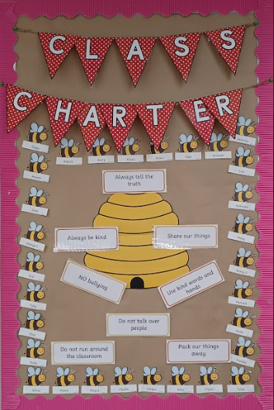
Welcome
OUR CLASS TEAM
Teacher – Mrs Skea-Strachan
Teaching Assistants
Mrs Parkinson
Miss Hopkins
Years 1 & 2

Slide 4
Welcome
Routine
Each morning we follow the same routine
Fluency Grammar during registration
Phonics and handwriting
English
Break
Maths fluency
Maths
Lunch
Years 1 & 2

Slide 5
Welcome
Timetable
Monday : Computing, Art & DT
Tuesday: RE, PE & Music
Wednesday: Forest School and PSHE
Thursday: PE & Humanities
Friday: Science & Guided Reading
Years 1 & 2

Slide 6
WELCOME
Stormbreak
3 times a week

Slide 7
Welcome
Things your children will need
Forest School Kit
PE kit in school every day
Reading book and reading record
Please LABEL EVERYTHING!!
Years 1 & 2

Slide 8
Welcome
READING
Fluency book – Love of reading book
(a book they like to read and find a little easier, therefore tend to enjoy reading)
Decoding book – Linked to phonics learning
(we have taught them the skills to decode this)
Please bring book and record to school every day
If you would like to come and listen to readers please do let us know
Years 1 & 2

Slide 9
Welcome
HOME LEARNING
Phonics Workbooks:
A workbook based on the sound we have been learning.
Sent out on a Friday,
Due back the following Friday.
Years 1 & 2

Slide 10
Welcome
HOME LEARNING
Phonics Spellings:
A bookmark with spelling taken from the sound we have been learning
Sent out Friday
TEST – the following Friday
Years 1 & 2

Slide 11
Welcome
HOME LEARNING
Maths:
A task sheet every 2 weeks sent out on a Wednesday and due back the following Wednesday (based on previous learning)
Writing a class story :
Take home on a Friday and return by Wednesday the following week. Write about your adventures with Nutty.
Years 1 & 2

Slide 12
Welcome
Nutty
Years 1 & 2

Slide 13
Welcome
GEMS
Certificates Friday Assembly
Years 1 & 2

Slide 14
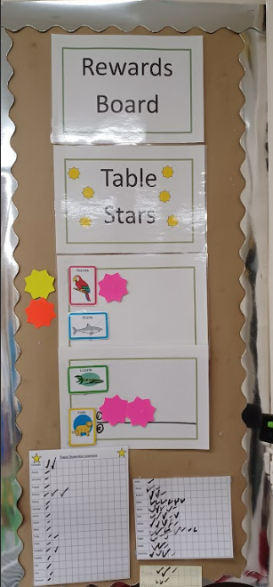
Welcome
REWARDS
Individual Stickers
Table Stars
Certificates Friday Assembly
Years 1 & 2

