Slide 1
Eco Committee worship 22/09/22

Slide 2
Eco Committee Who is your class representative? Meet us!

Slide 3
The Eco Committee vision To encourage the whole school community to protect, explore and appreciate our environment

Slide 4
Recycling 1. try to reuse 2. what can go in our recycling bins in the class room? 3. Tough stuff bin 4. food waste at break and school dinners

Slide 5
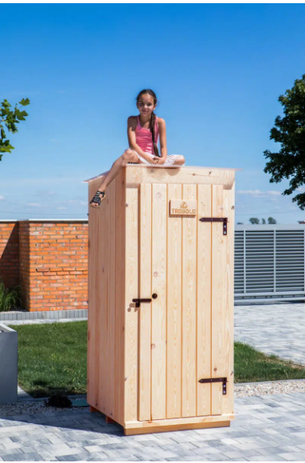
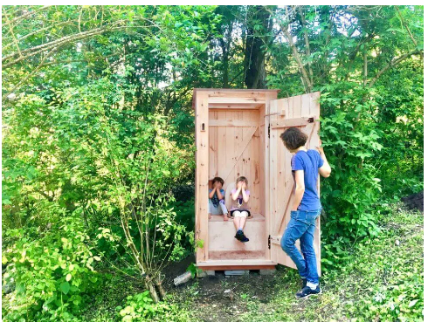
Forest school – composting toilet

Slide 6
A tribute to the queen

Slide 7
Our Decarbonisation project – climate change

