Slide 1
Diamond Class
Year 1

Slide 2
Staff
Monday – Mrs Legg
Tuesday – Mrs Regan
Wednesday - Mrs Regan
Thursday - Mrs Regan
Friday – Mrs Legg
Support staff – Mrs Tibbs, Miss Amor, Ms Durose and Mrs Brooks
Mrs Brooks and Ms Durose (lunch time supervisor)
Mrs Taylor (volunteer readers)

Slide 3
Morning Timetable
8.45 Spelling starter of the day task
9.00 Register and Phonics (Topaz class)
9:30 English (includes learning about grammar, punctuation and spelling)
10.30 Break time THURSDAY: TUCK SHOP 30p!
10.45 Fluency maths
11.00 Maths (includes mental maths and subitising)
11.45 Story Time / Storm Break / Track run!
12:05 Lunch

Slide 4
Afternoon Timetable – Autumn 1
Mondays – Art and computing
Tuesdays – P.E., R.E., Music
Wednesdays – Forest school and PSHE
Thursdays – PE and topic
Fridays – Science (and more forest school!)
COOL Time

Slide 5
Home Learning
Mathletics – Monday (checked Monday)
Spellings – Shared through email on Mondays and checked through a dictation task on Friday
Reading (10 minutes reading every day) and engagement with reading for pleasure (library books and home reading)
Phonics words (real and nonsense words) – Phonics Screening (June)

Slide 6
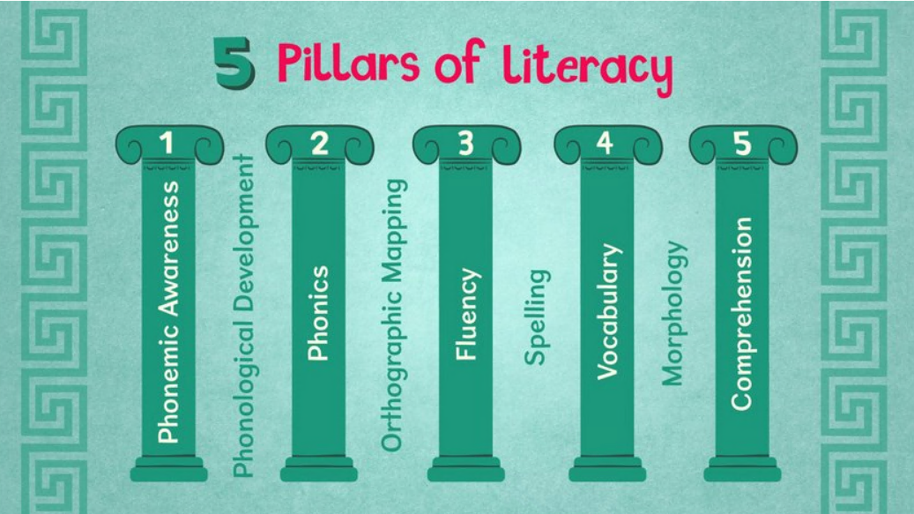
Reading at Home
Little and often is fine! Do your best to read daily with your child. It does not have to be the whole book!
Re-read each book multiple times for fluency and comprehension… …remind your children that it’s not a race! ☺
Modelling reading to your child at this stage is also really important. Sharing books together is a special time to share.
At school, an adult will listen to your child read once a week (in addition to daily reading foci in phonics). We WELCOME volunteer readers ☺ to increase this! If you, grandparents, other family member, or a friend of the school can spare any time at all in an afternoon to listen to readers, please, please do let us know. You may not necessarily be assigned to Diamonds Class, but you would free up other volunteers to come in to us and hear more readers.

Slide 7
The Books We Send Home…
These books need to remain in your child’s book bag (and brought into school) each day alongside their reading record. It is really important, that any reading you do at home, is logged in your child’s reading record as a celebration of their progress.
Reading Diary – please record, even if it is just initials and page numbers.
You will also find logins and websites in the diaries, as well as any notes about lunchtimes etc.
Please ensure the Home-School agreement pages are read and signed.
Decoding Book – matched to your child’s current phonics level. They should be able to sound out and blend these words, and recognise most of the tricky words in this book. Please re-read with your child to help them become more fluent before requesting to change the book!
Apologies for typos!

Slide 8
The Books We Send Home…
Fluency Book – these are usually books that are easy to decode for your child, so they can read them more independently. This means you can discuss the text, what is happening , make predictions, discuss emotions etc more readily without getting caught up in decoding the individual words. Most often, these texts are texts that your child has already read and it is a great opportunity to talk about the vocabulary used.
Library Book – Your child has chosen this book from the library as their reading for pleasure book. Again, read it together, enjoy it, and occasionally ask your child to play games, like ‘spot all the letter s that you can see on this page,’ or ‘can you see the word ‘and?’

Slide 9
Changing Your Child’s Reading Books
Your child’s book changeover day is a Monday. Please ensure it is clear that you have read both books at least twice and you are ready for them to be changed.
Please note, Monday will be our only book changing day.
LIBRARY BOOK CHANGE IS FRIDAYS ☺

Slide 10
What they will need
Book bag every day (with reading records, books etc). Unfortunately we do not have space for ruck sacks.
Named water bottle every day
Named waterproof coat every day
Please also ensure your child has spare underwear in their PE kit/book bag. You never know when an accident can happen, and it is always good to have spares in school 😊. This also includes socks.
Forest school (stays in school) – really important for Tuesdays! If they attend club – ideally needs two sets (let us know if this is a problem)
PE – Tuesday and Thursday (please make sure children have trainers rather than plimsolls and that their hair is up on a PE day (with no jewellery).
Wellies that remain in school
School shoes that are named (both shoes please ☺)

Slide 11
Celebration Worship
Fridays
If your child has any certificates, trophies or achievements they’d like to share from outside of school then please send them in on a Friday for Mr Roberts to share.
Star postcards
Gem award
100 stickers

Slide 12
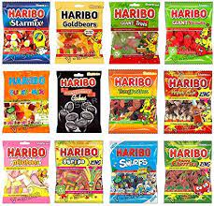
Birthdays

Slide 13
Extra-curricular Learning:
Trips
Visitors
Topic days
Village community project
Village walk
Church visit
Harvest walk

Slide 14
Communication
Website
Emails
Telephone / at the door (arrange a meeting)
SEND meetings

