Slide 1
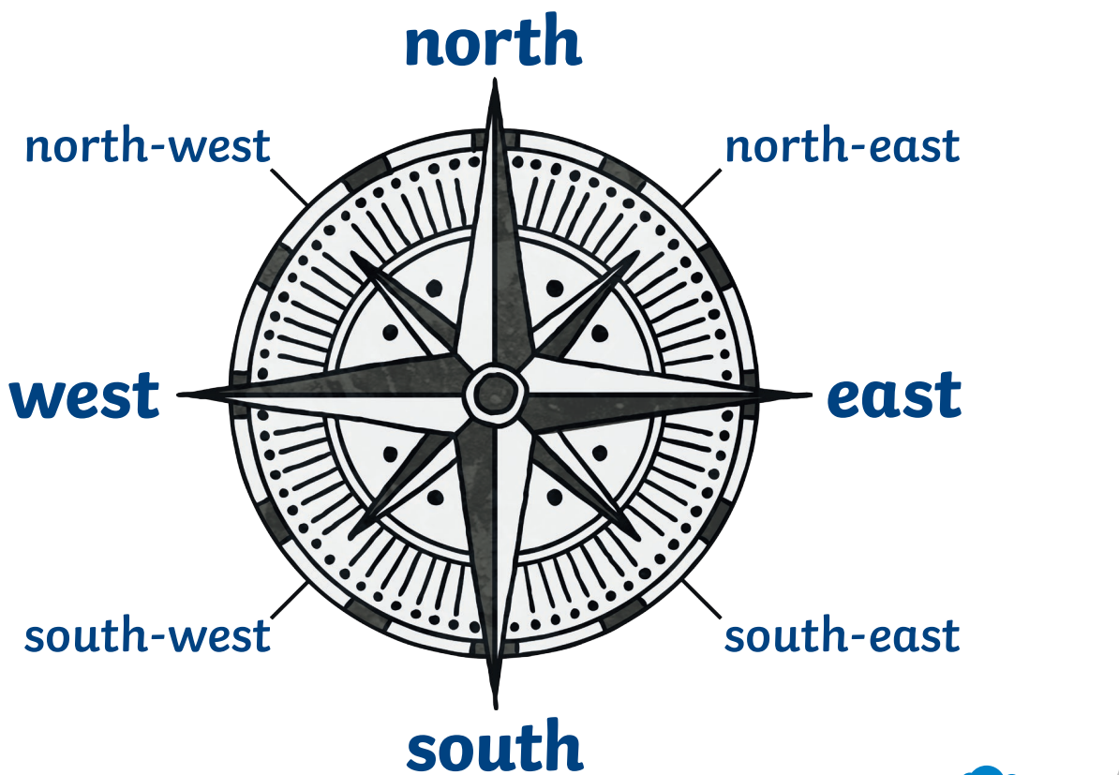
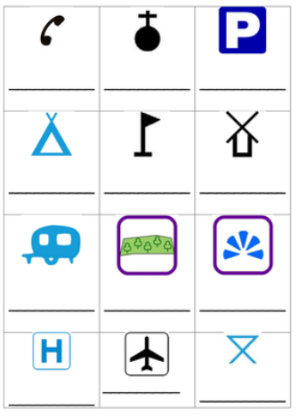
Rubies Class Physical Education– Knowledge Organiser
P.E. Focus | Orienteering | Year 3/4 | Autumn
What? (Key Knowledge)
Directions | 8 key compass directions: See diagram
Map Reading | Recognise symbols on a map
 | Understand that maps and aerial view pictures are not the same, but can be depicting the same area.
 | Recognise these features on aerial photographs
 | A map is always drawn using a plan perspective.
Map features | Can recognise features on a map (Road, cities, churches, beaches, mountains ).
 | Every map needs: A key A scale A title
Directional language | To describe the features in a location or a route.
What? (Key vocab)
Spelling | Definition
Map | A diagrammatic representation of an area showing physical features
Aerial Photo | A photo taken from the air/ above
Key | Explains the meanings of symbols
Plan view | A 2D representation of a 3D object
Symbol | A mark or drawing used to represent an object or area
Route | A way from getting from a starting point to a destination
Near | A short distance away
Far | A large distance away
Location | The place where something is
Orienteer | To find your way across areas using a map.
Diagrams and Symbols
Possible activities
Children can use the compass directions and positional language to direct their classmates from one area to another. Using a map template, children can follow directions (2 N 1 E ) to place map symbols in the correct locations. Children can draw a picture map of a story, or their journey to school etc, identifying key features on the way. Children given a map without a key, can you interpret what the symbols mean – annotate

