Slide 1
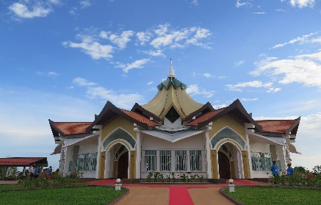
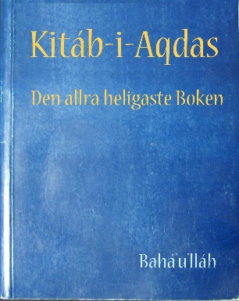
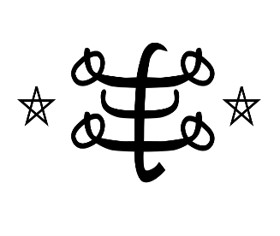
What is the Baha’i Faith?
Our Enquiry Steps:
What is the Baha’i Faith?
Who was the Bab?
Who was Baha’u’llah?
Why is Unity so important in the Baha’i Faith?
How do Baha’is pray and who do they worship?
Is there a special place of worship for Baha’is?
Key Vocabulary | Definition
5 Fingers | Bahaï, Bahaïs, Houses of Worship, Aqdas, Nine Sided Star
Bâb | The Bâb means ‘Gate’. He said he was the Gateway to the next religion, which would unite the world.
Baha’u’llah | The Glory of God
Bahaï | To be a Bahaï means that a person believes that Baha’u’llah is the manifestation of God for this time. A Bahaï strives to follow his teachings and observes his laws.
Unity | Being united or joined as a whole. Bahaïs believe the world should be united. That all human beings should be like one family.
Houses of Worship | Houses of Worship are the religious place of worship. They are also known as Mashriqu’l-Adhkar.
Ridvan | Ridvan means ‘Paradise’. It is the name for the Garden of Ridvan outside Baghdâd. Baha’u’llah stayed there for twelve days.
Nine Sided Star | A symbol of perfection and unity.
RE Skills to develop
I can discuss why worshippers choose to attend a particular place of worship and what it means to belong.
I can reflect on my own values and explore what I can learn from the value of believers.
I can describe religions and world views, connecting my ideas and prior learning.
Key Artefacts and Symbols
Key Stories
Baha’u’llah wrote many books and letters, and Abduu’l-Baha also wrote many books and letters which Bahaïs see as special.
Finally Baha’u’llah’s Great Grandson Shoghi Effendi wrote lots of books and letters which Baha’is use to better understand the writings of Baha’u’llah and Abdu’l-Baha. The most important of these books is the’ Aqdas’.
One God, One Religion, One Human Race
Our End Points:
Emerging: I can talk about who Baha’u’llah was and say why he was important to his followers.
Expected: I can explore some of the key concepts and main figures of the Baha’i Faith. I can explore the teaching of Unity.
Exceeding: I can explain who the Bab and Baha’u’llah were in relation to the Baha'i Faith. I can describe the Festival of Ridvan and say why it is important to Baha’is.

